Slide 1


Molecular Dynamics for Neutrons
Deeper Reading
Dr. Jeff. Armstrong (ISIS)
Notes:
Hi everyone, my name is Jeff Armstrong and I am the instrument scientist on TOSCA. As the last lecture I hope you have some attention span left! Today we will talk a bit about molecular dynamics and how it can be used to extract more information from neutron experiments. We will dive into the fundamentals of MD and also give some practical examples.
I actually come from an

Slide 2
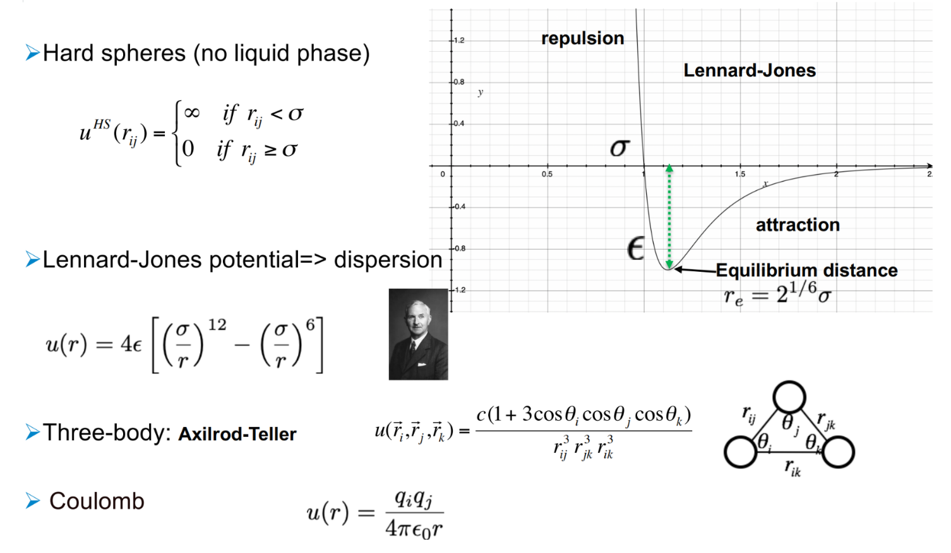
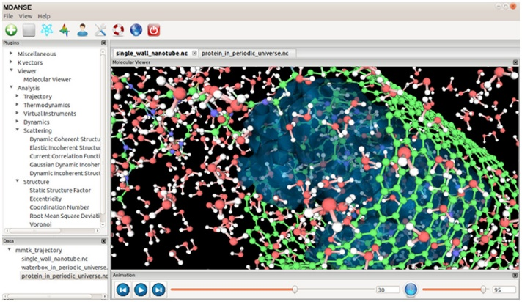
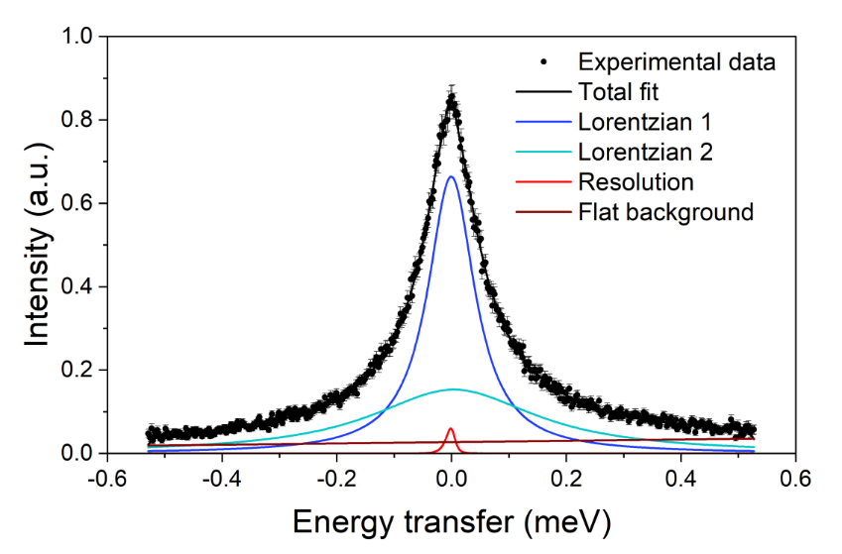
What would I like you to take away from today?
A basic understanding of the mathematical underpinnings of MD
Sign posting to the array of software that is available for both setting up and analysing MD
A convincing argument about how and why MD and Neutron scattering can and should be used to extract more information from one another
Notes:
-Highlight the basic essence of MD (generates a movie from a model)
-This “movie” can be interrogated
-Highlight how extra information can be obtained from experiments with MD

Slide 3
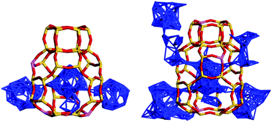
What is Molecular Dynamics?
A method/model that generates a movie at the atomic scale, letting us examine or interrogate the motions/structure of the atoms
Example: Small molecule diffusion in Zeolites
This can help us understand the links between the atomic properties and the macroscopic properties of a system
e.g. Diffusion of products in catalytic zeolite can be a rate limiting effect
Notes:
-Highlight the basic essence of MD (generates a movie from a model)
-This “movie” can be interrogated
-Highlight how extra information can be obtained from experiments with MD

Slide 4
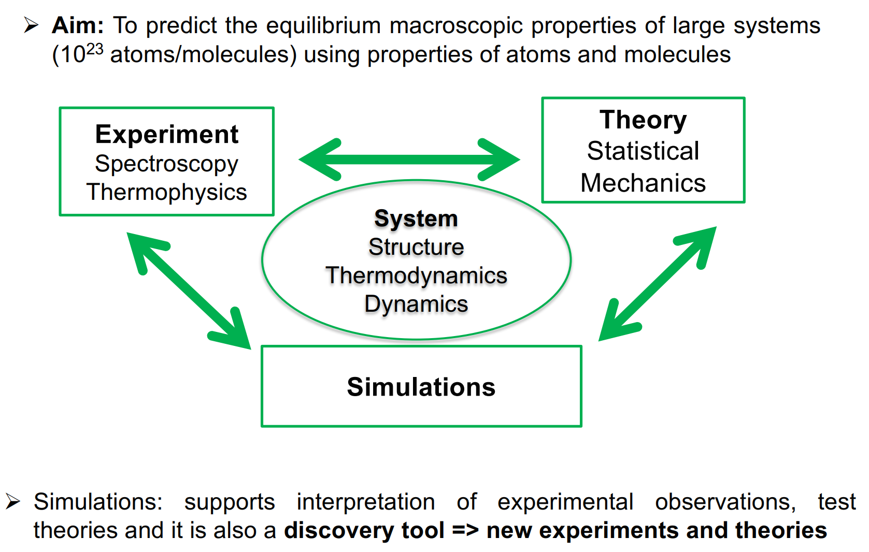
Basic objective of MD (cycle of consistency)
Solid: Primitive cell
Liquid: Radial distribution
Phase transitions
Thermal expansion
Self-diffusion
Rotational diffusion
Viscosity
Thermal conductivity
Notes:
Interplay of model accuracy, theory of stat mech and experiment (self consistency cycle)

Slide 5
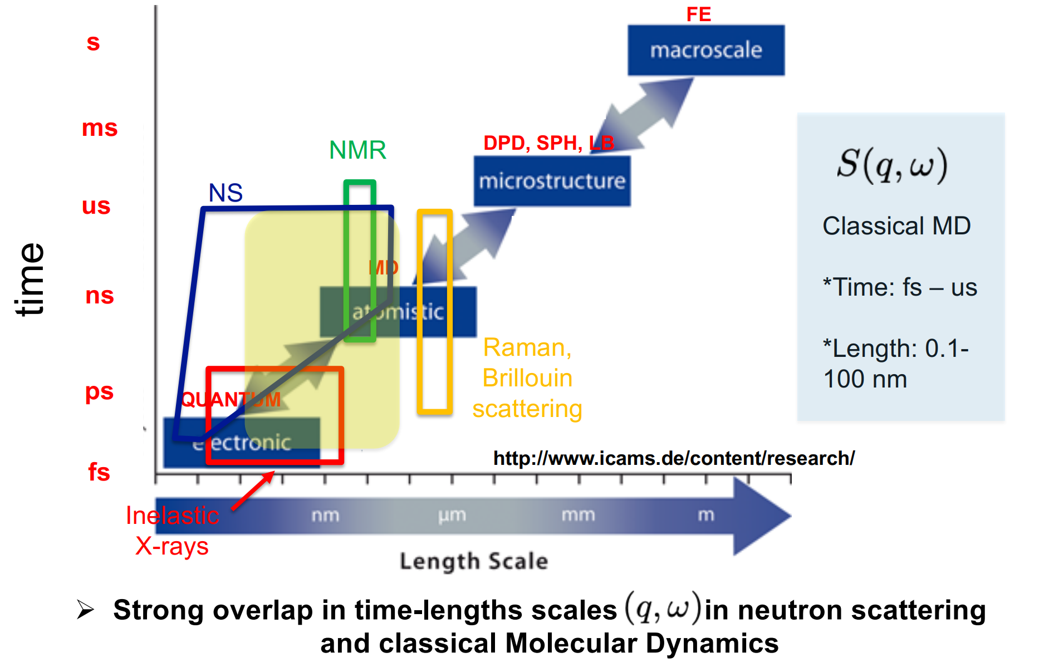
Multiscale ladder (what scale does MD probe?)
Dynamics (QENS)
Structure (SANS/diffraction)
Large scale structures/surfaces (reflectometry)

Slide 6
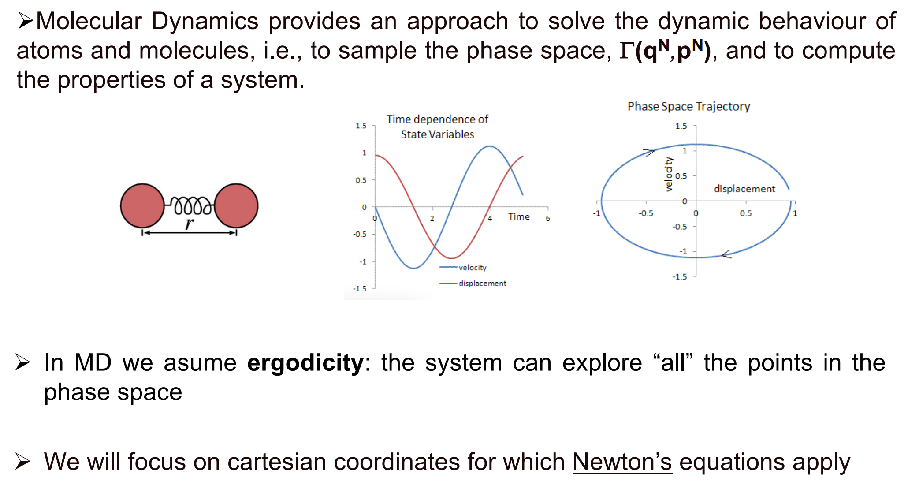
We generate “movies”, but formally we are exploring Phase Space
Easily Visualised with the case of a harmonically coupled system
Thermodynamic quantities can be calculated as temporal averages of these state variables

Slide 7
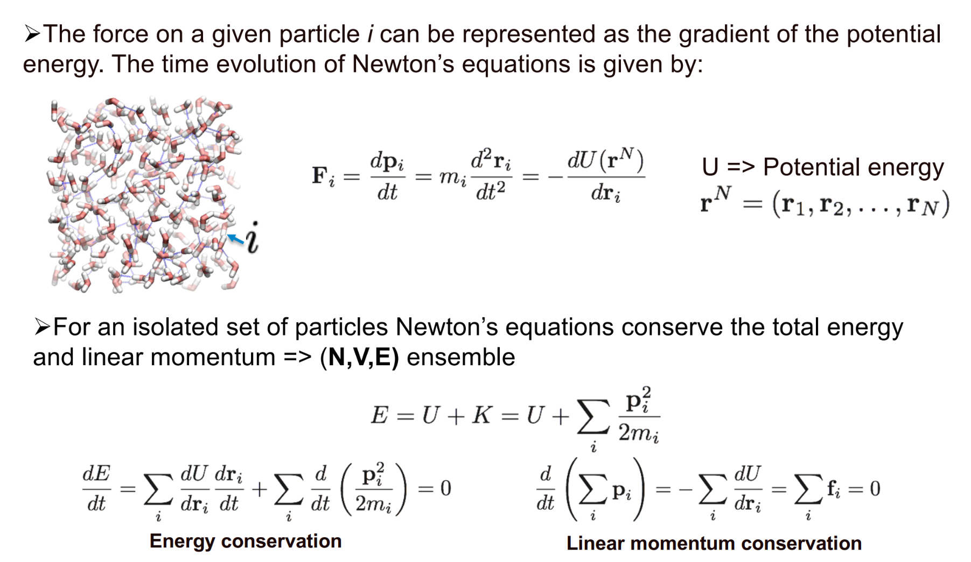
Revisiting Newton (the basic math of MD)
A mathematical term describing the time evolution of the positions
Force-field usually expressed as potential energy
Something that is fully determined by the current state of the system (Force-field)

Slide 8
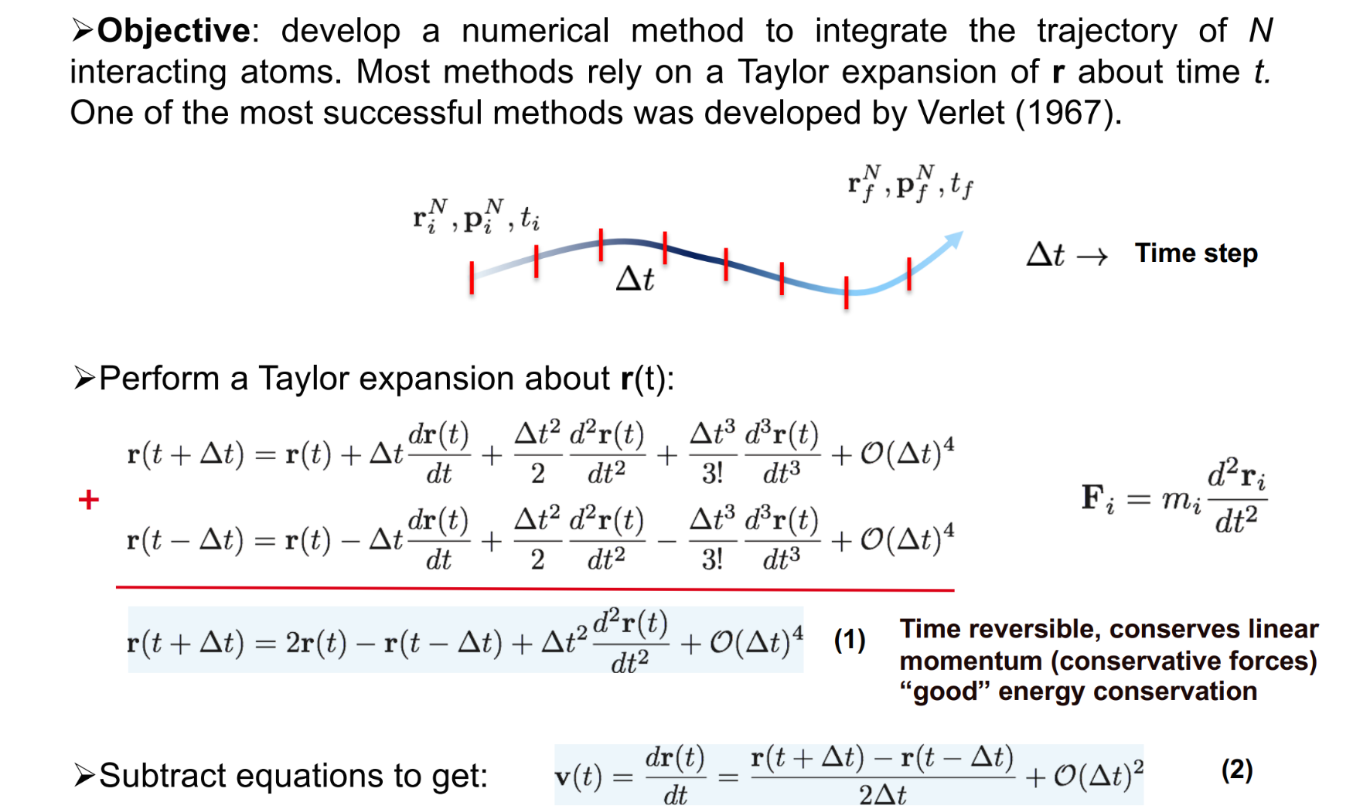
How do we solve this in practice?
The closer we are to our initial “known” state, the more accurate the truncated Taylor expansion will be (i.e. small time-step).
Current step
Previous step
We have this! F/m

Slide 9
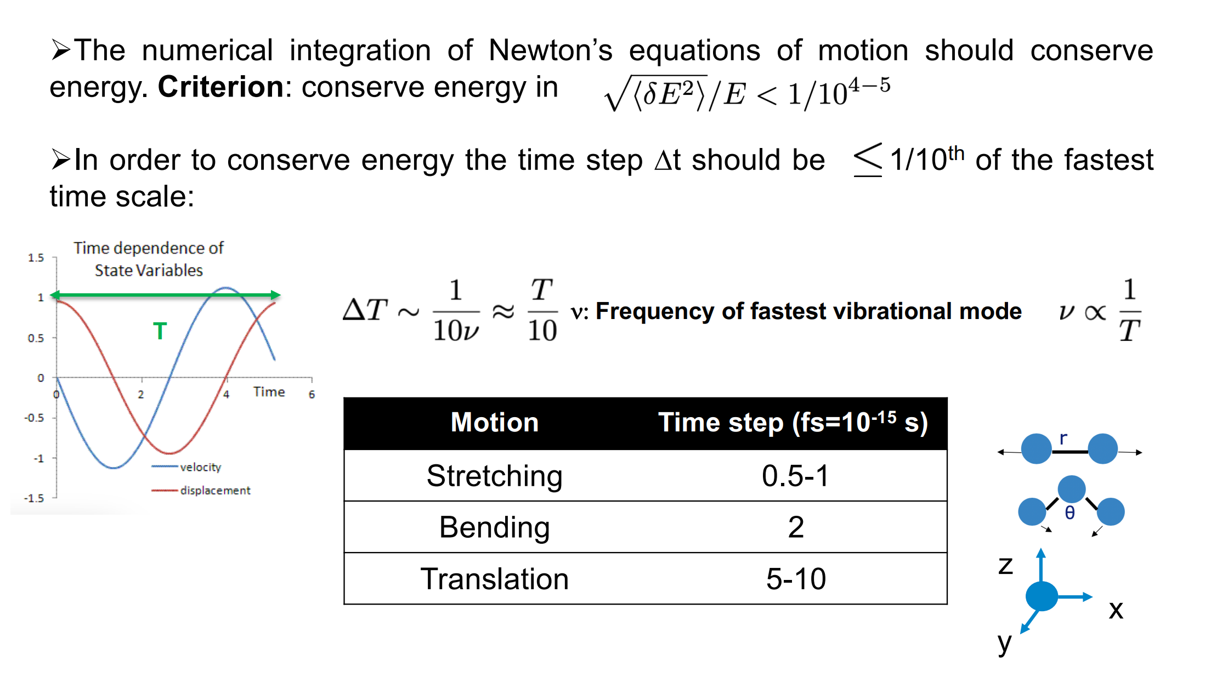
Time steps and energy conservation
Useful rule of thumb
Note: Rigid models are often available, and perform very well in many cases

Slide 10
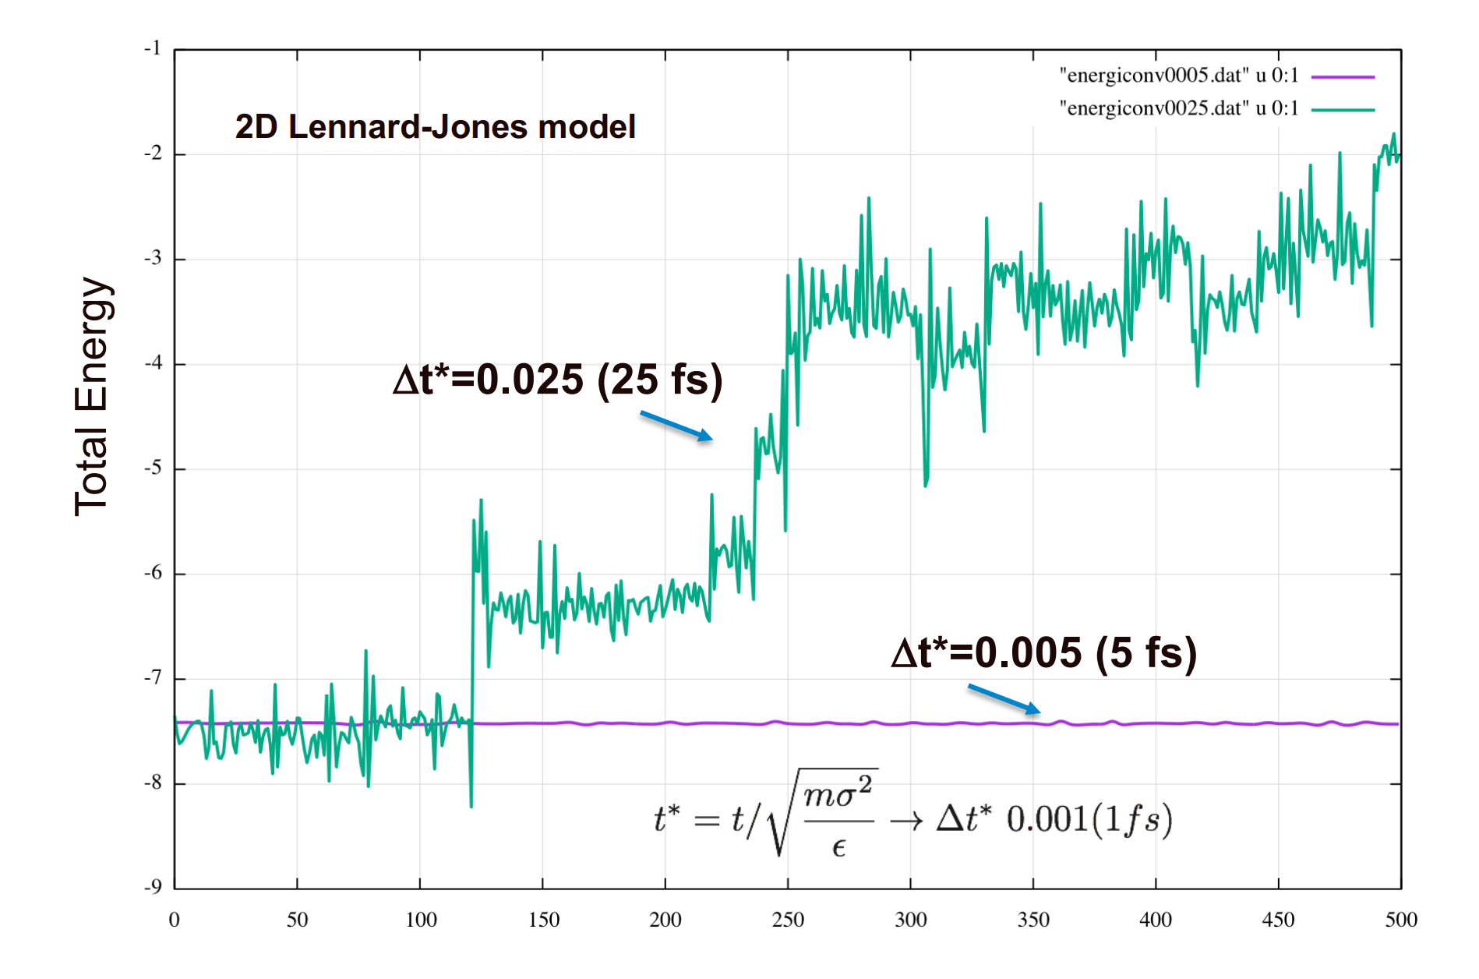
Example energy conservation
You probably want less than a 1% energy drift over the course of the simulation

Slide 11
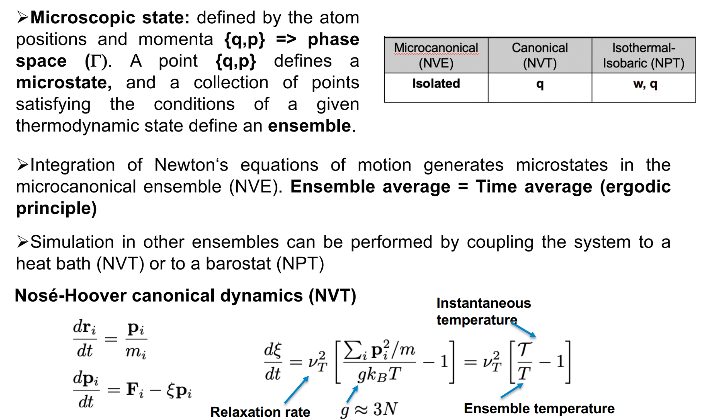
Thermostats and Barostats
Guide the system to a given temperature or pressure
It is often appropriate to run a simulation in NPT at a desired pressure, and from the average box dimensions, switch to a NVE ensemble

Slide 12
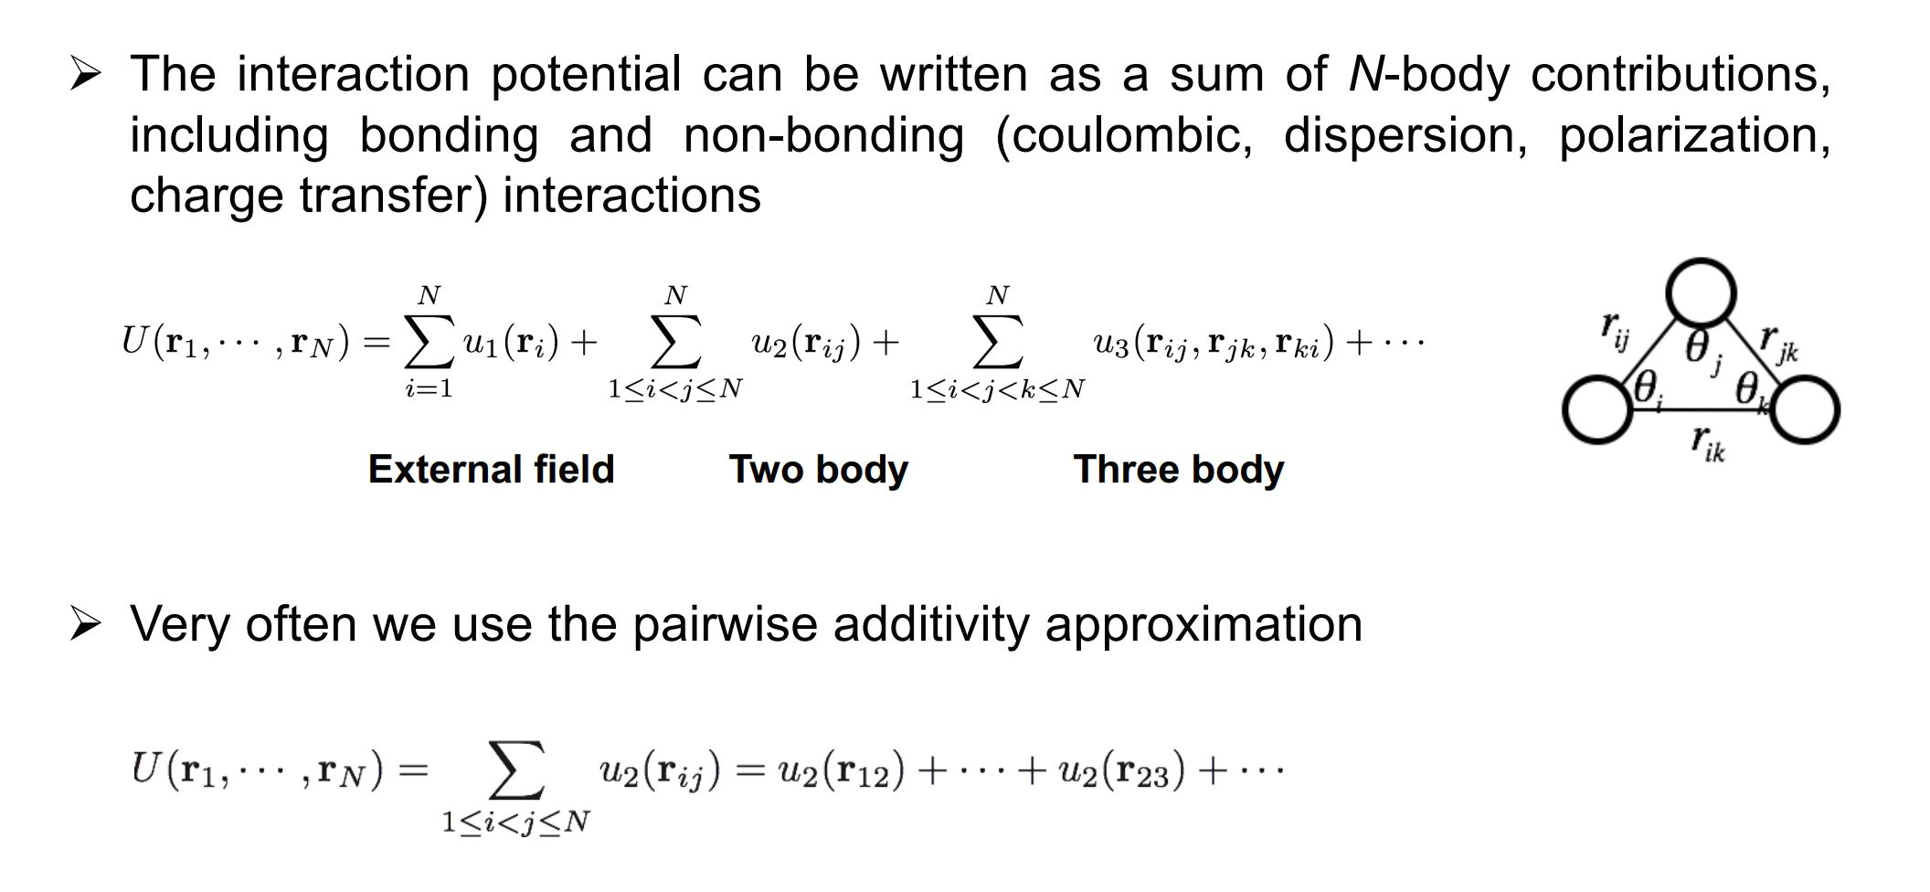
But what is the force-field?
Usually a potential energy that can be expressed as a function of the atomic positons
Higher order than pair potentials are very costly and rarely used

Slide 13

Interatomic potentials
Overlapping electron clouds
How would you simulate this!?
London forces
These have to be treated via special methods (e.g. Ewald)
This is due to 1/r² nature (energy drops off at the same rate as volume increases)

Slide 14
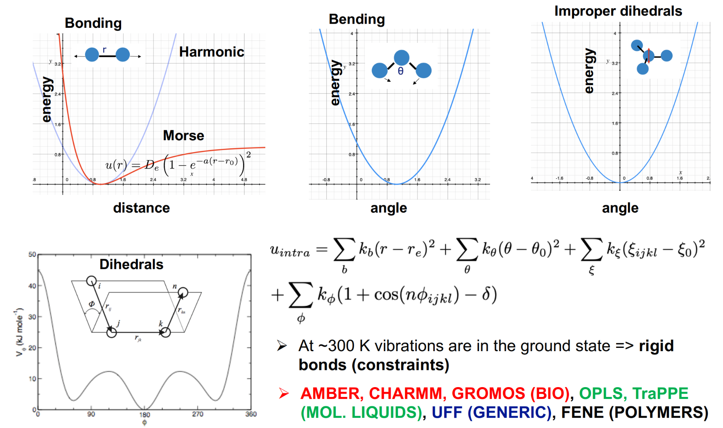
Intra-molecular terms
Very important for keeping planar geometry of molecules
Careful about dihedral convections in different codes/FFs

Slide 15
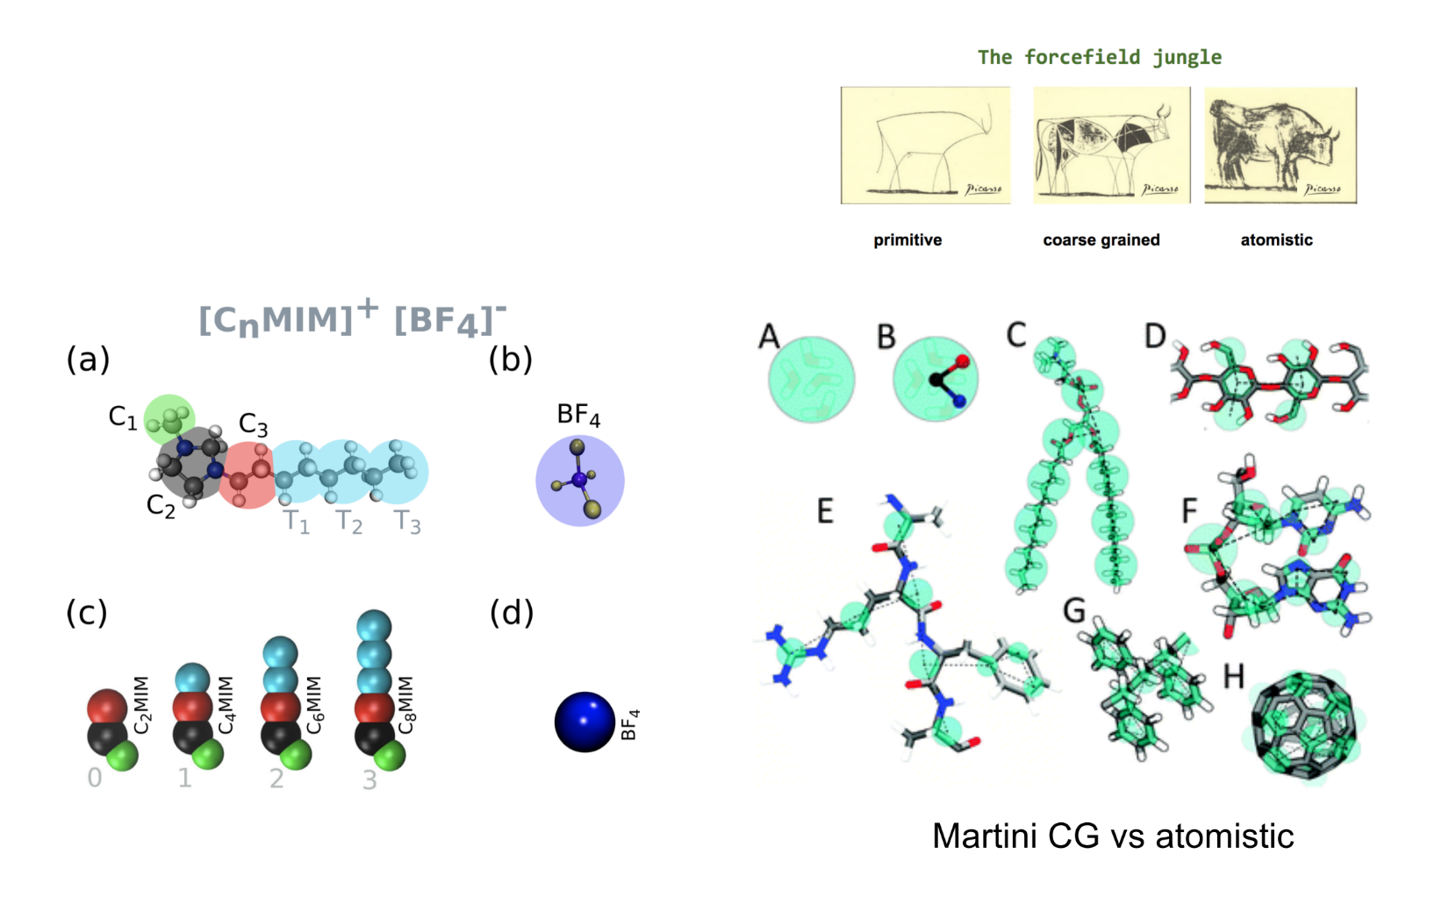
Coarse-graining (something to be aware of)
Particularly important for large systems in biology (lipid bi-layers, proteins etc.)
Can be important for SANS and reflectometry
Note that dynamic quantities can be very wrong

Slide 16
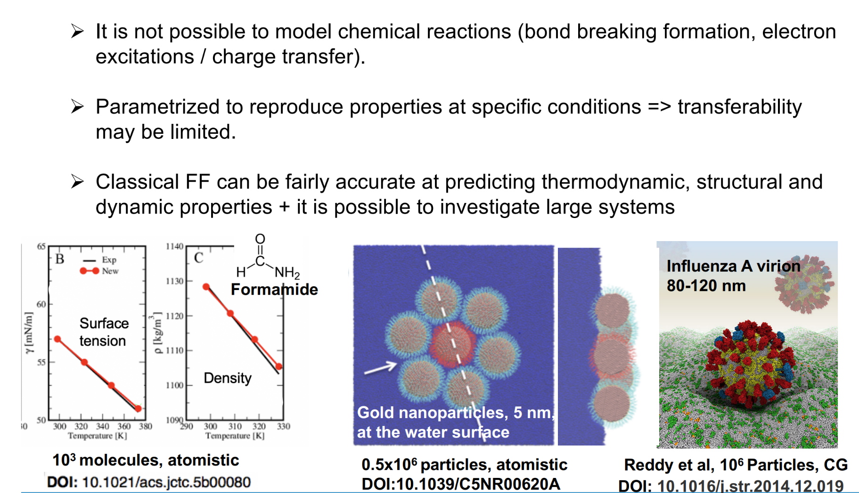
Where do these force-fields come from and what are their weaknesses?
Multi-scale approaches do exist
Phase transitions for example may be shifted

Slide 17
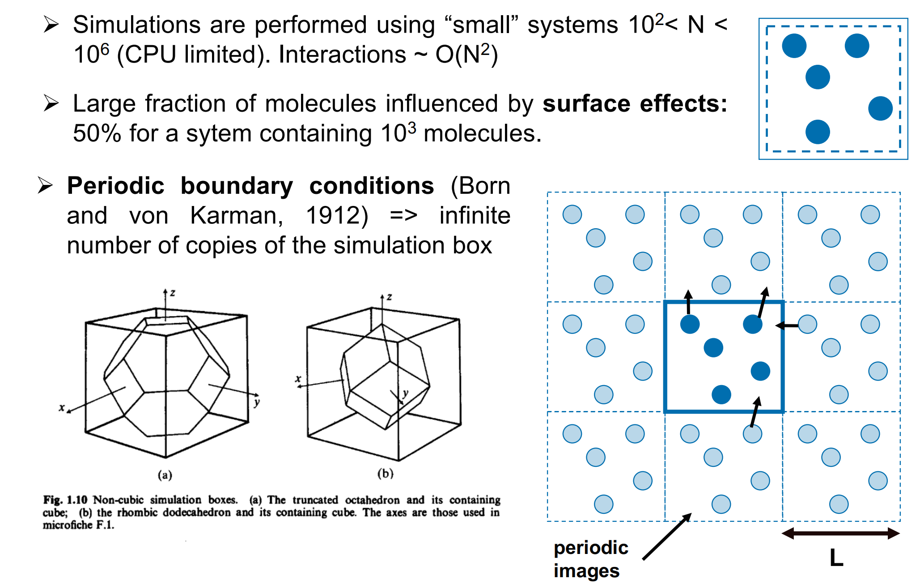
Periodic Boundary Conditions (we can’t simulate a whole macroscopic system)

Slide 18
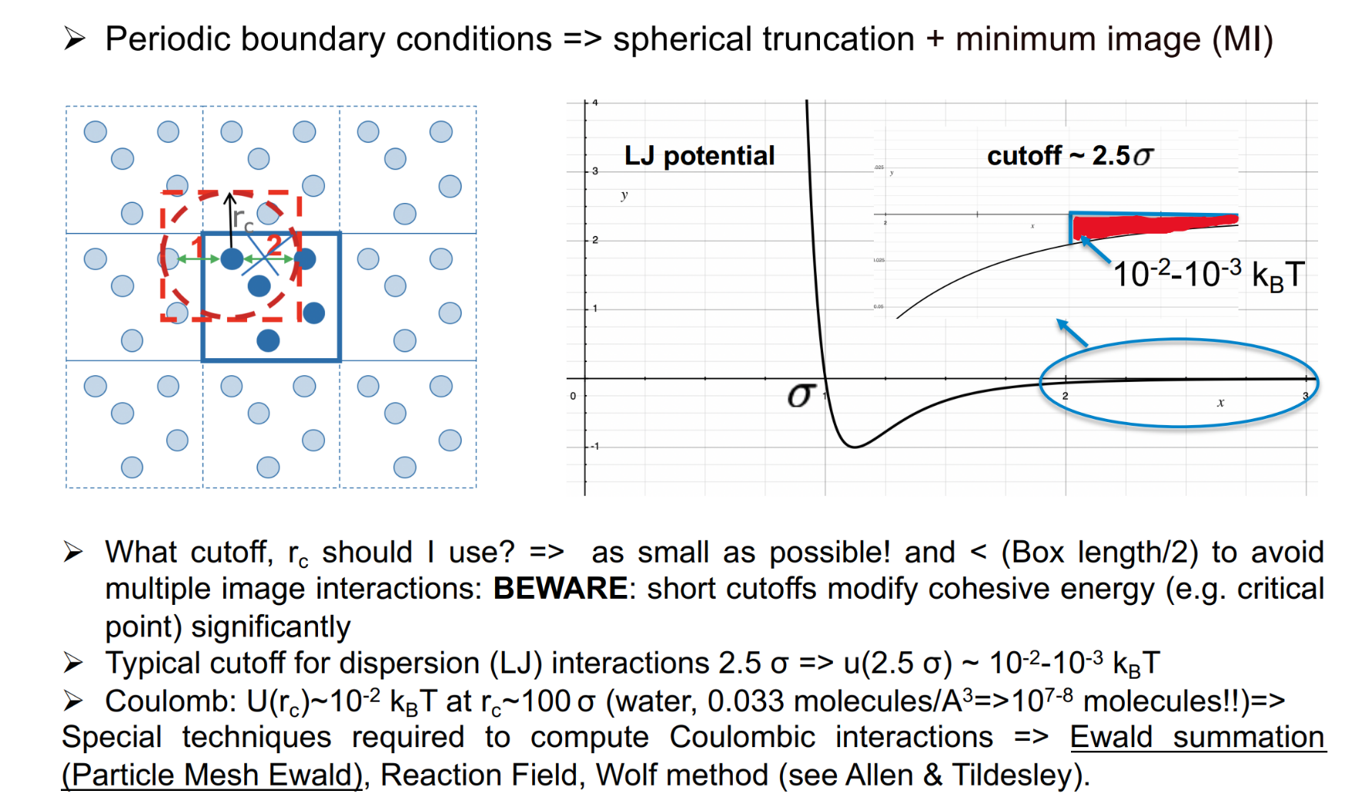
Cut-offs and minimum image convention
You also need to be aware of neighbour lists, which keep track of which atoms are within a given radial distance of one another, meaning only a sub-set of distances need to be calculated each step

Slide 19
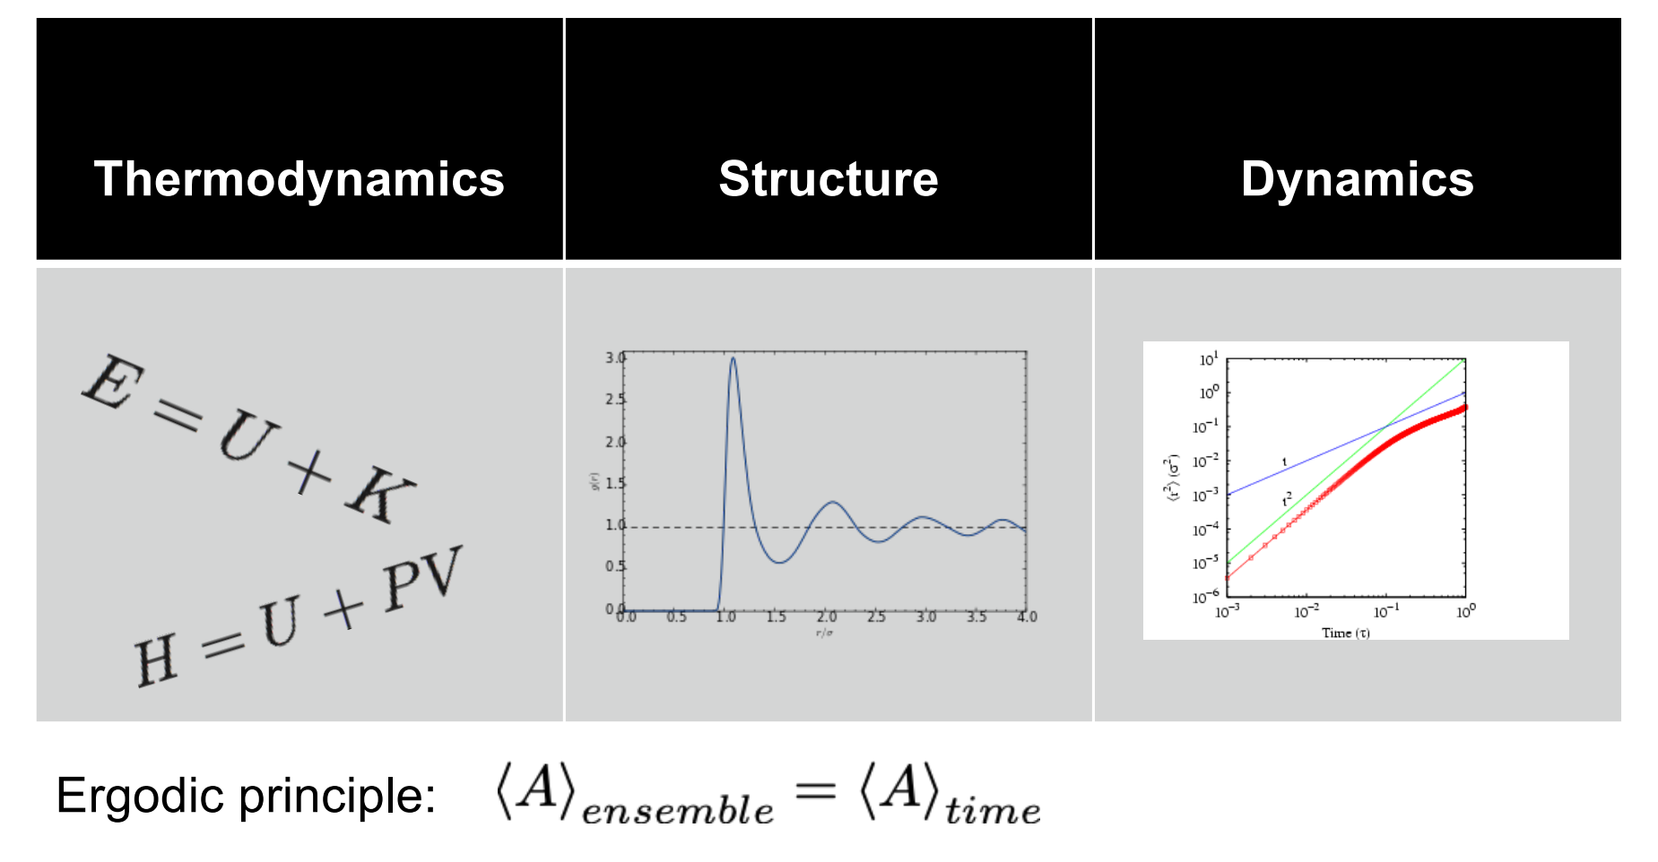
What can we measure?
Energy and entropy changes as a function of T etc.
Atomic positons relative to each other and surfaces
Individual or collective motions of atoms
Average over time is the average over all possible configurations

Slide 20
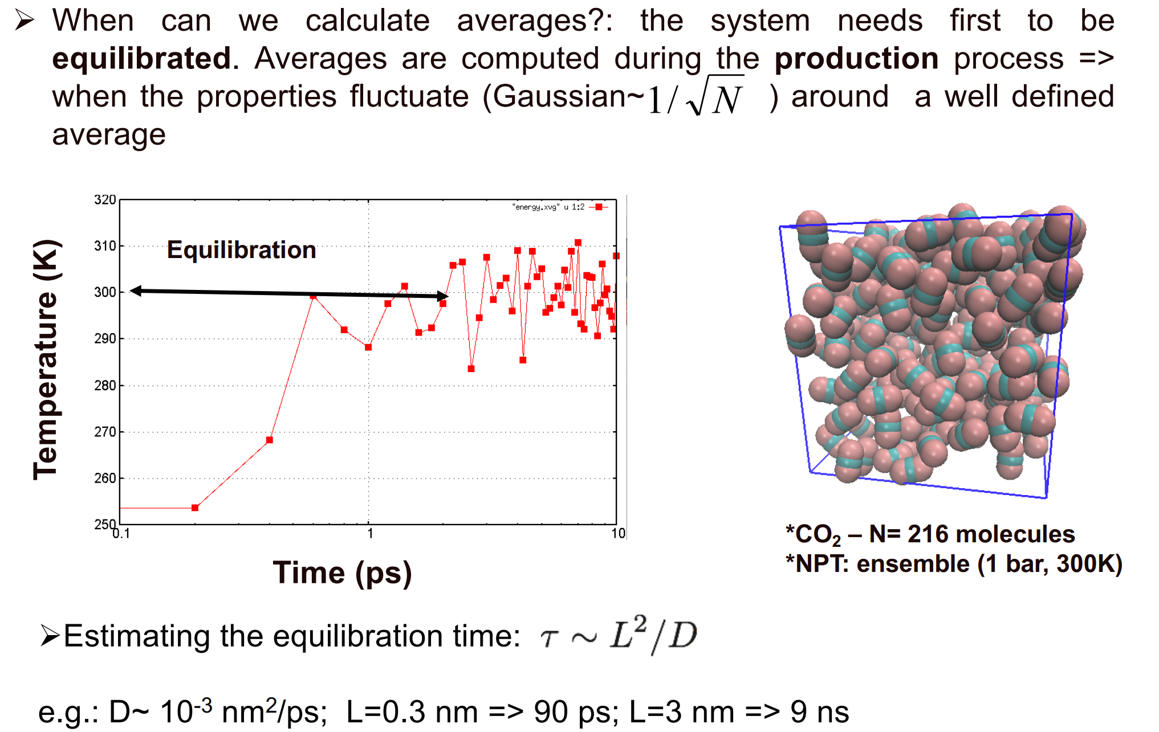
Equilibration (when are we ready to analyse?)
Has the running average plateaued?
Is the typical variation consistent with time?

Slide 21
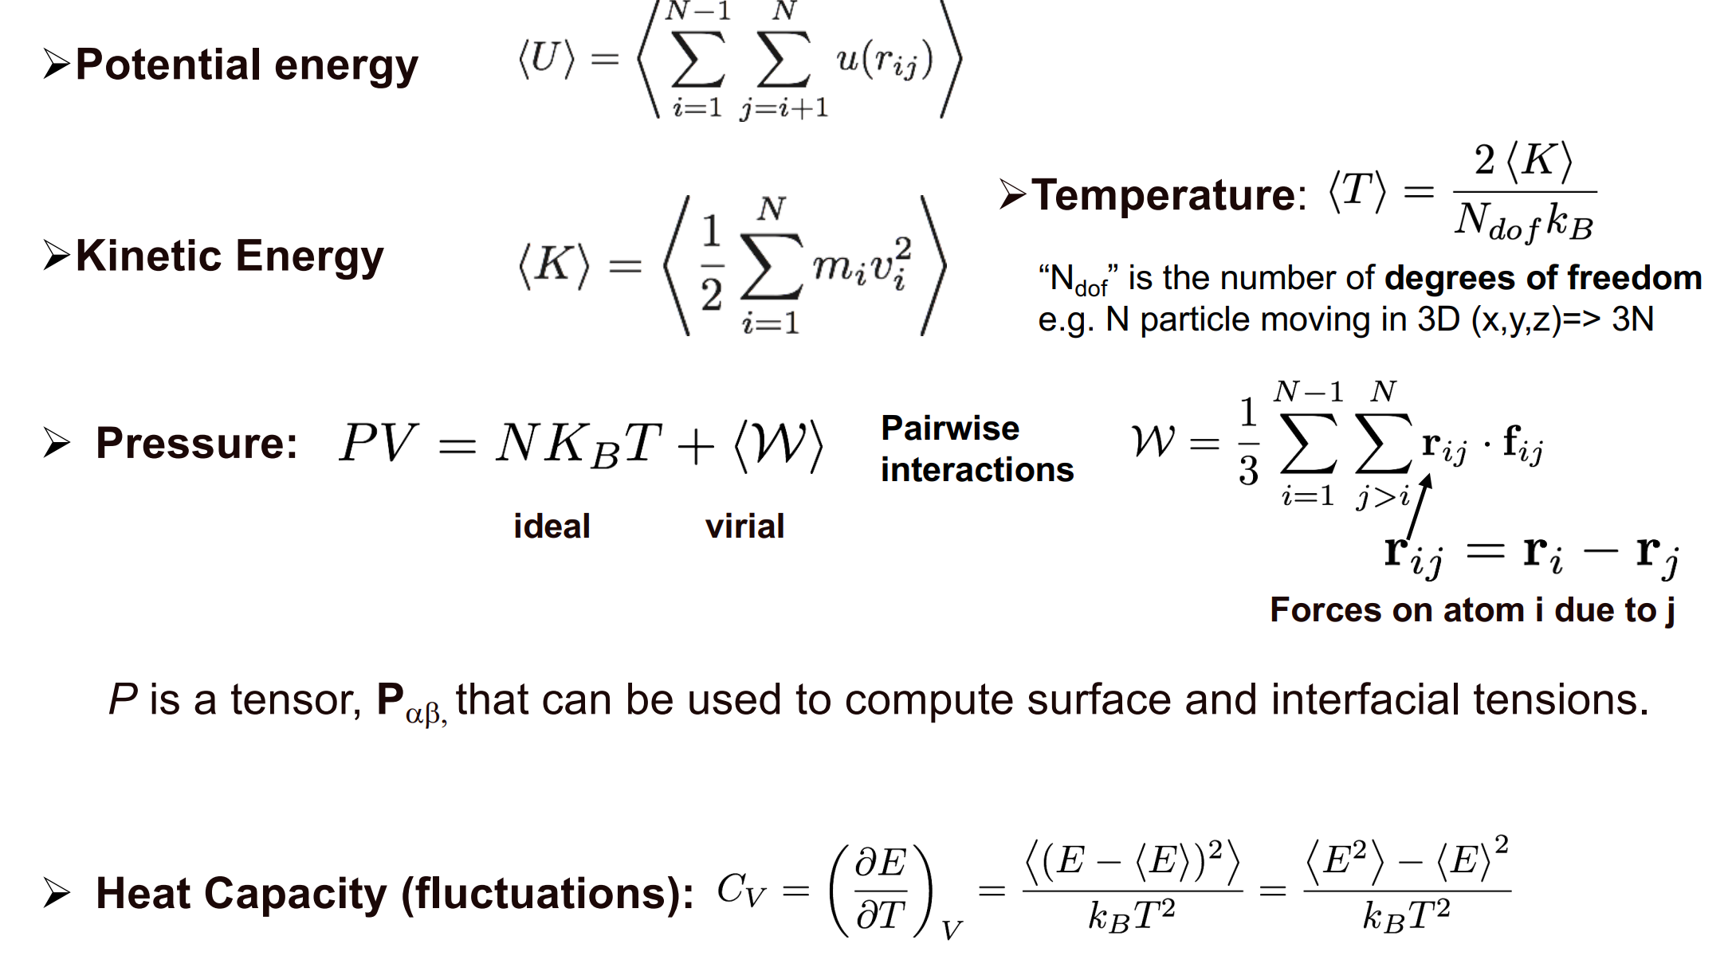
Thermodynamic quantities
These can be useful quantities to assess equilibration
Also very sensitive to phase changes of various orders (including dynamical transitions e.g. Rotor phase)

Slide 22
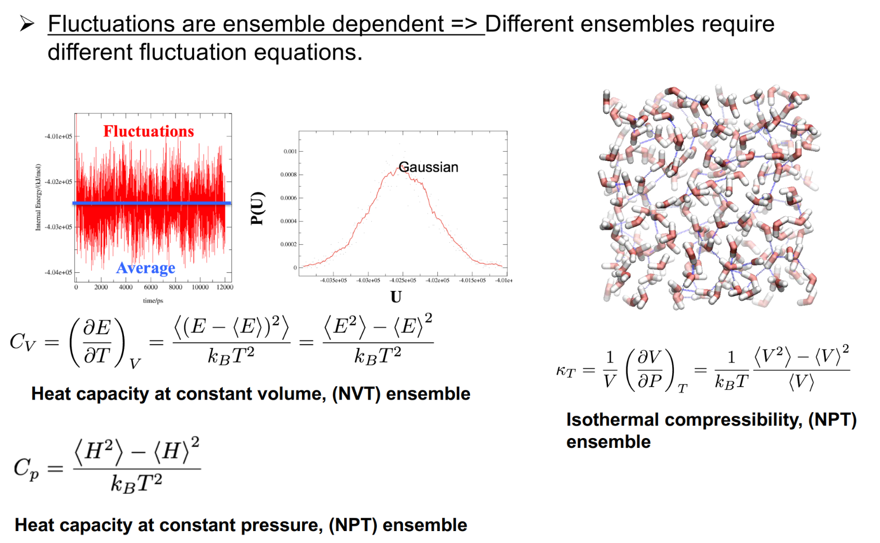
Fluctuations

Slide 23
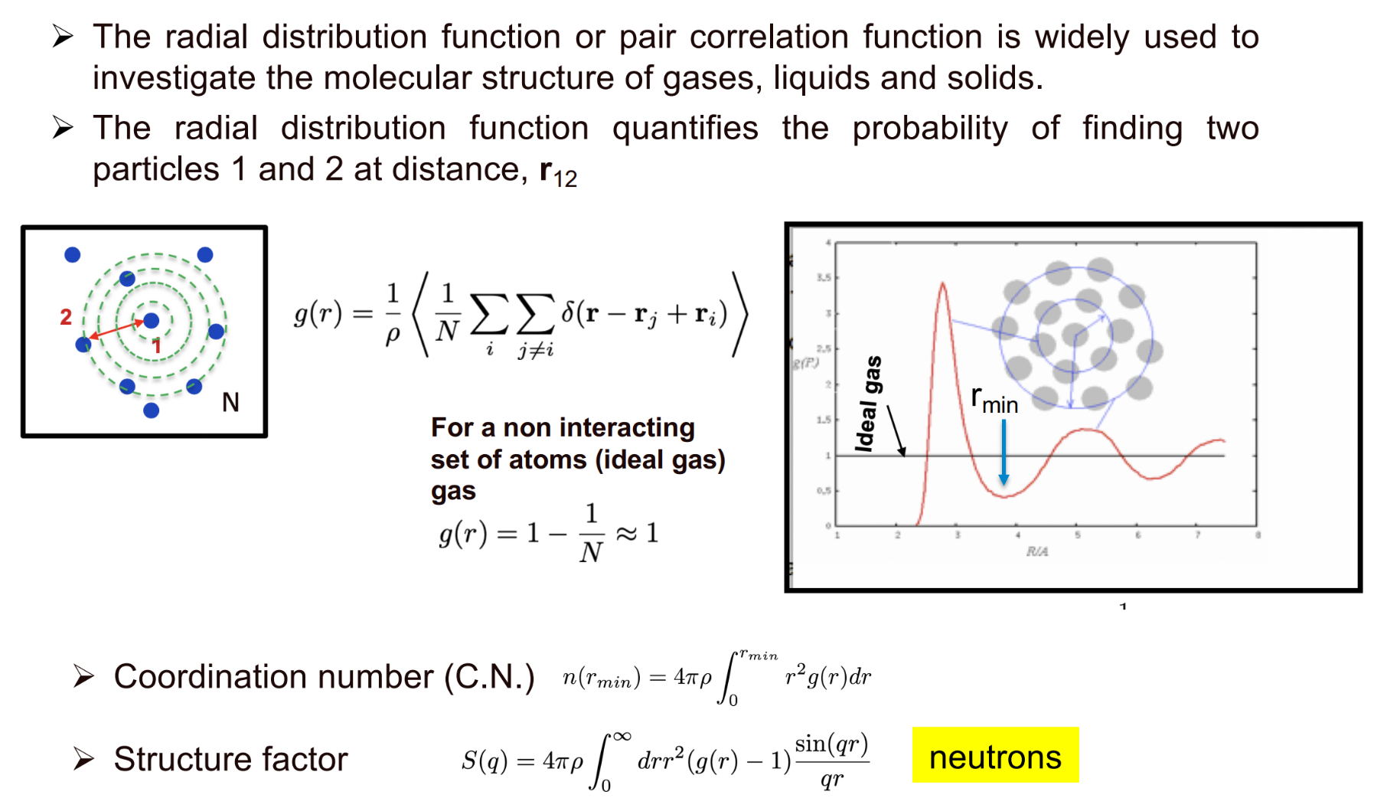
Radial Distribution Function
In practice this is counted within given shells

Slide 24
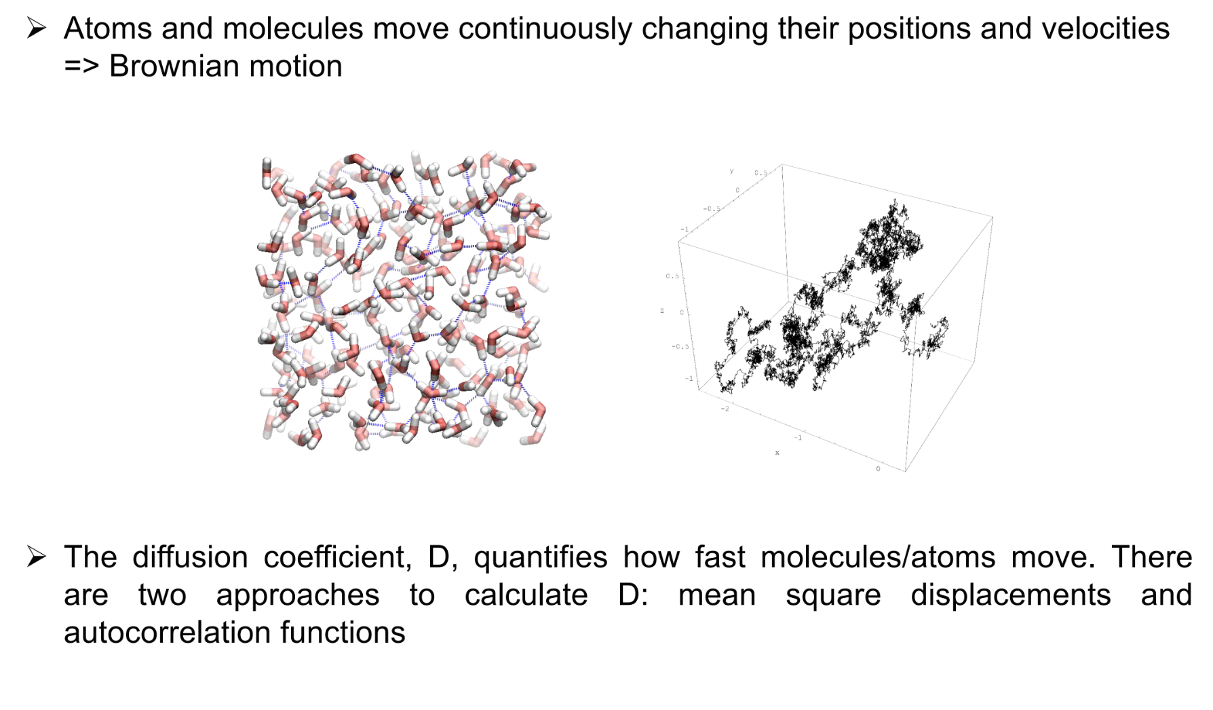
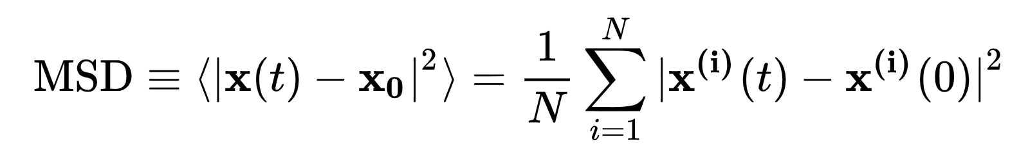
Dynamics (Self-diffusion coefficient)

Slide 25
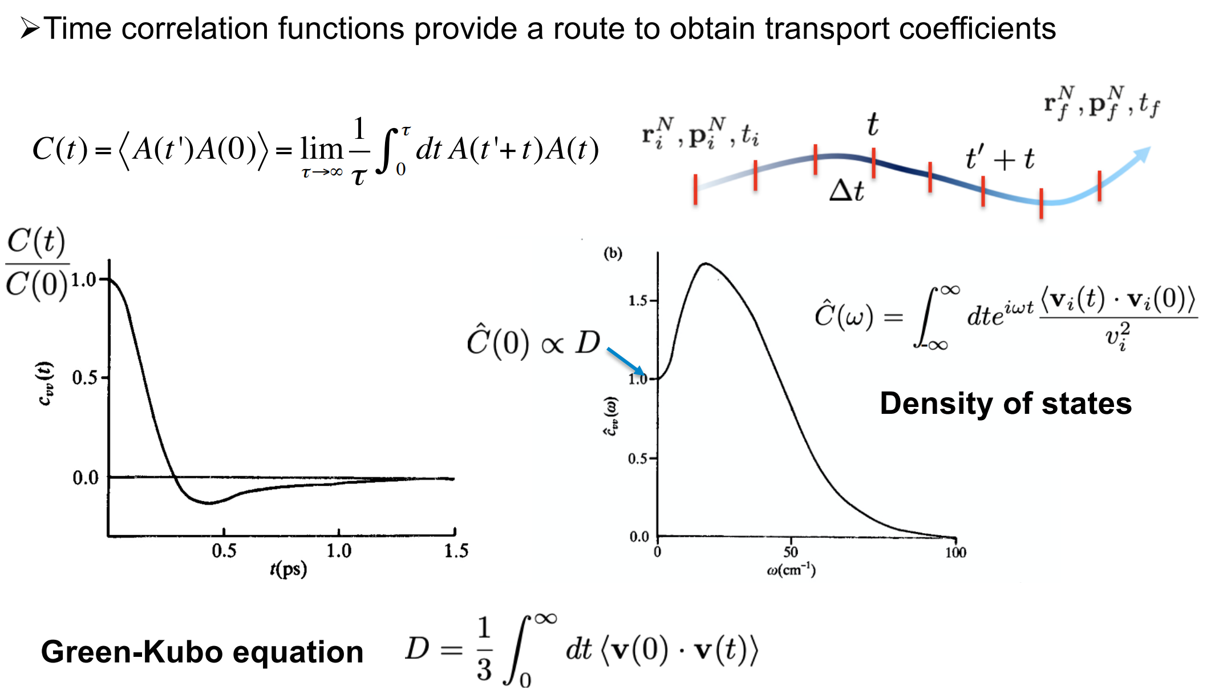
Correlation functions
Some quantities may also involve cross-correlations

Slide 26
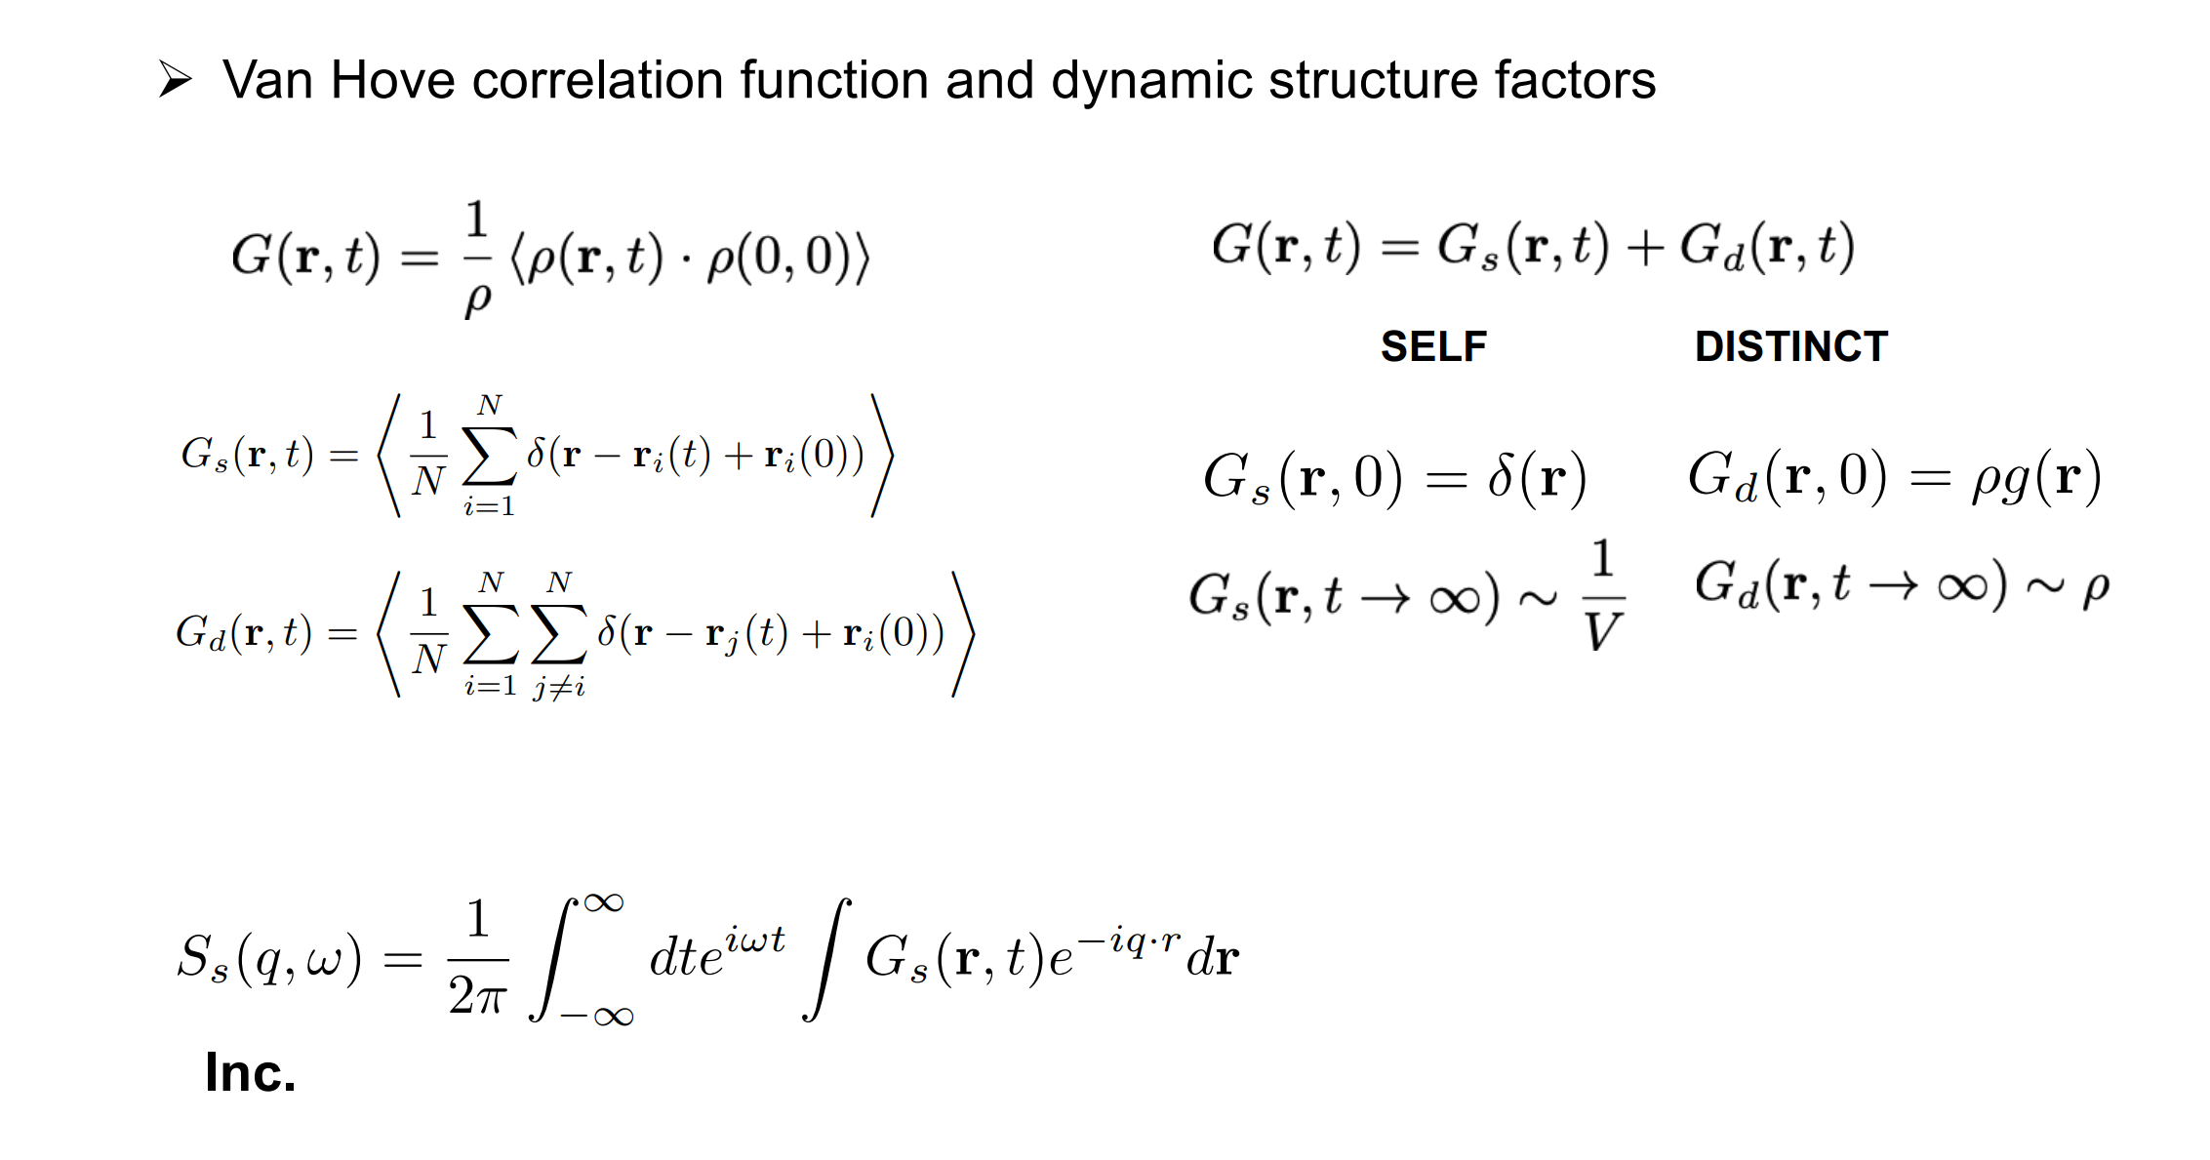
Van Hove (link with Neutrons)
Dynamic structure factor is the spatial and temporal Fourier Transform of the Van Hove Eqn.

Slide 27
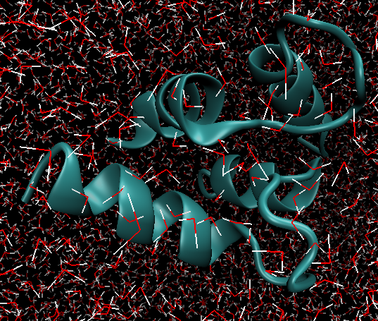
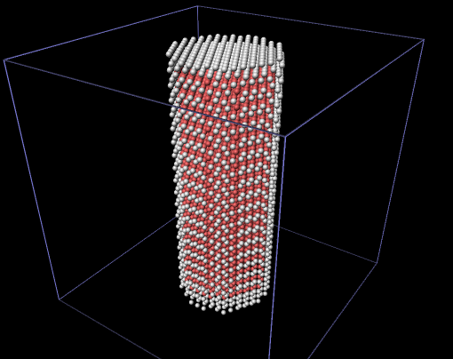
What MD package to use in practice?
Many flavours of MD (DL POLY, GROMACS, LAMMPS, Not to mention AB INITIO MD which also produces trajectories)
Your choice will depend on your use (Gromacs: Fast and therefore good for large systems, but poor flexibility, LAMMPS very flexible but slower; good for complex geometries).

Slide 28
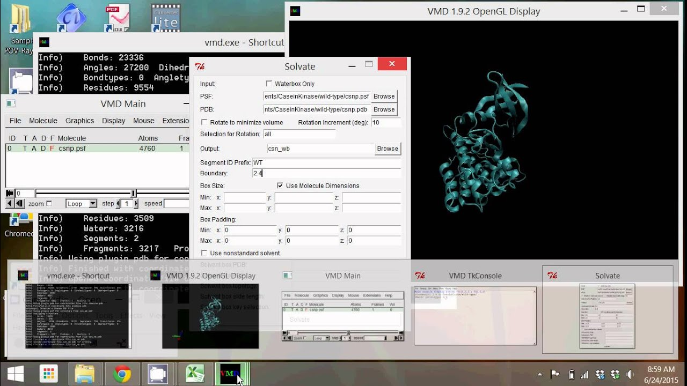
Setting up your simulation
Setting up the configuration for an MD simulation is often the most challenging aspect (especially if a solid/porous material is involved; relaxation of structure)
TOPOTOOLS (VMD), Materials Studio (requires a licence)
What can these tools do?
Set up the geometry
Set up the force-field
Analyse results from the trajectory

Slide 29
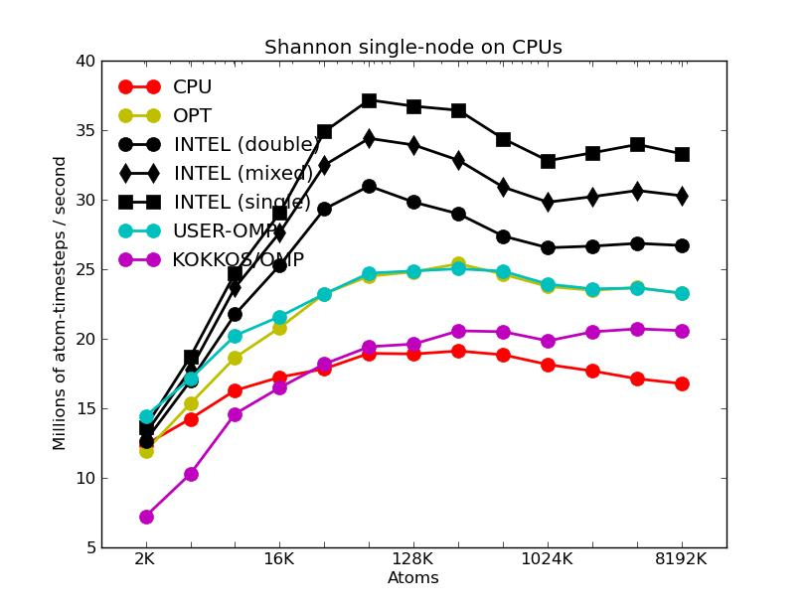
Running on a cluster and parallelisation
These calculations usually have to be run on a super computer cluster (ISIS provides use of the SCARF cluster to users)
How many CPUs is efficient? After a certain point more CPUs is bad as the communication between CPUs is more expensive than the gain
The best method is to run short tests with different numbers of CPUs on your system

Slide 30
We have our trajectory, now how do we compare to Neutron Scattering?
MDANSE is the go to analysis package for extracting neutron weighted results
We will now go through some of its features explicitly as there are some important things to consider when choosing different parameters
Resolution, neutron cross-section weighting, projection onto relevant Q
Notes:
Talk about loading in different file formats

Slide 31
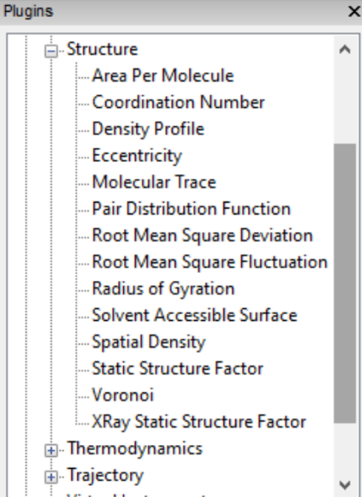
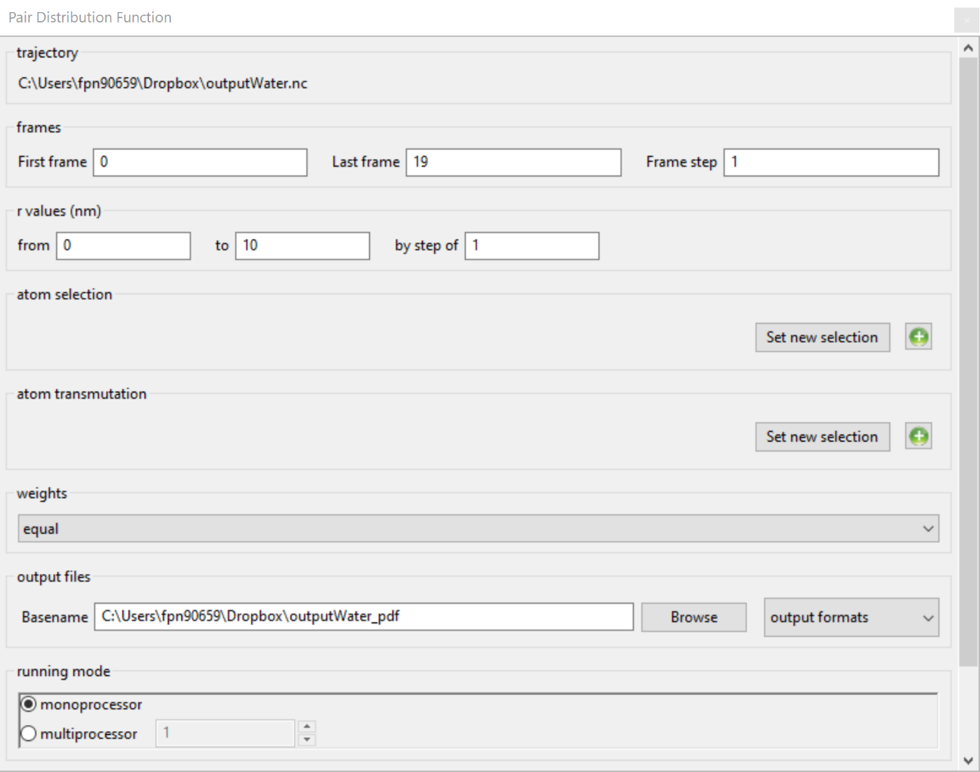
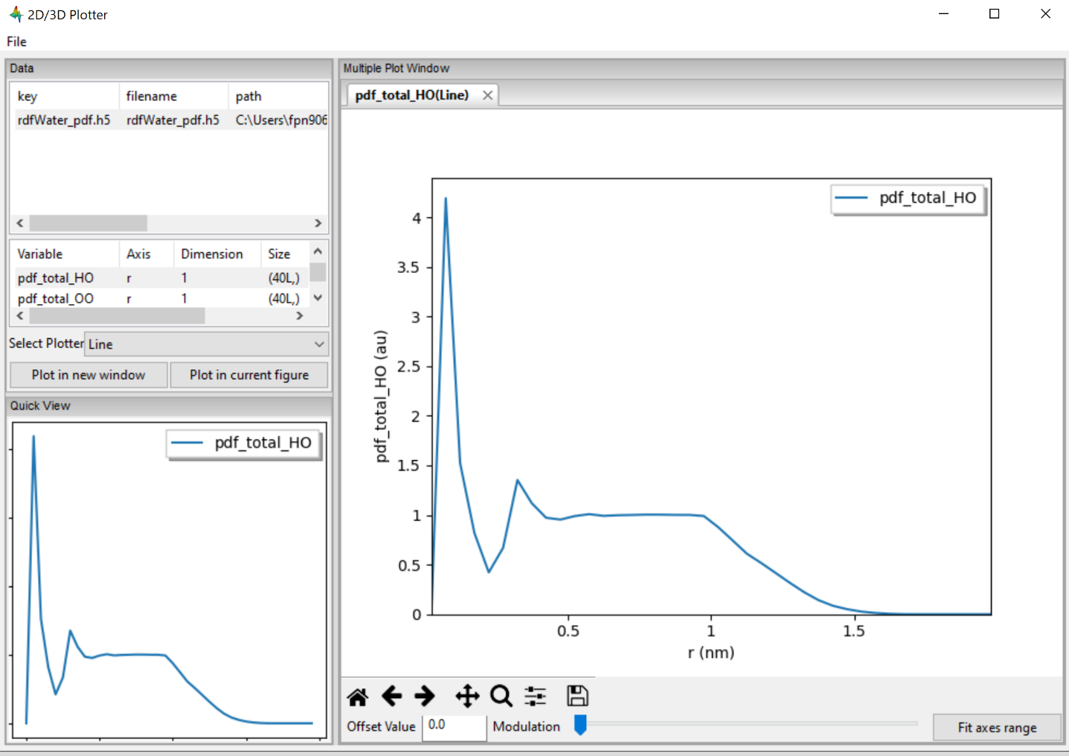
Structure (Radial distribution function)
Useful for comparison with SANS (E.g. Nimrod)
Structure typically favours infrequent printing (uncorrelated frames)

Slide 32
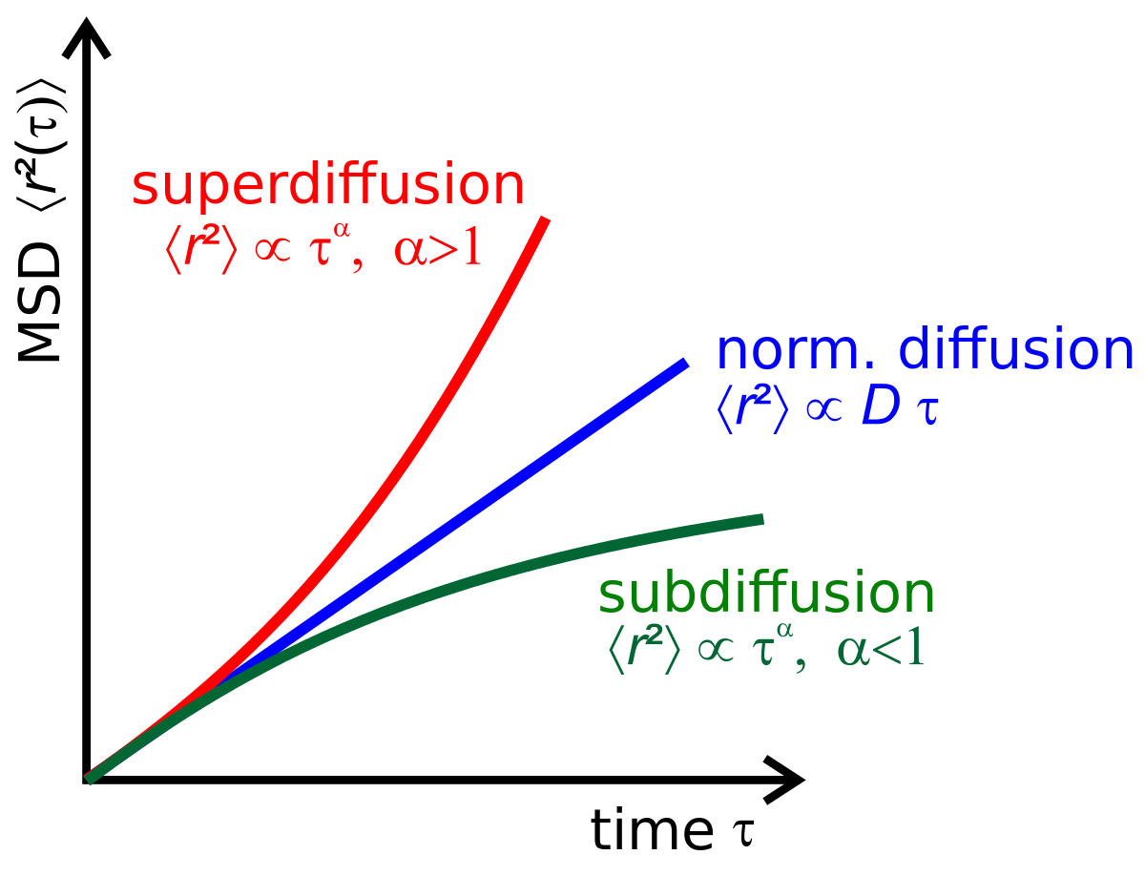
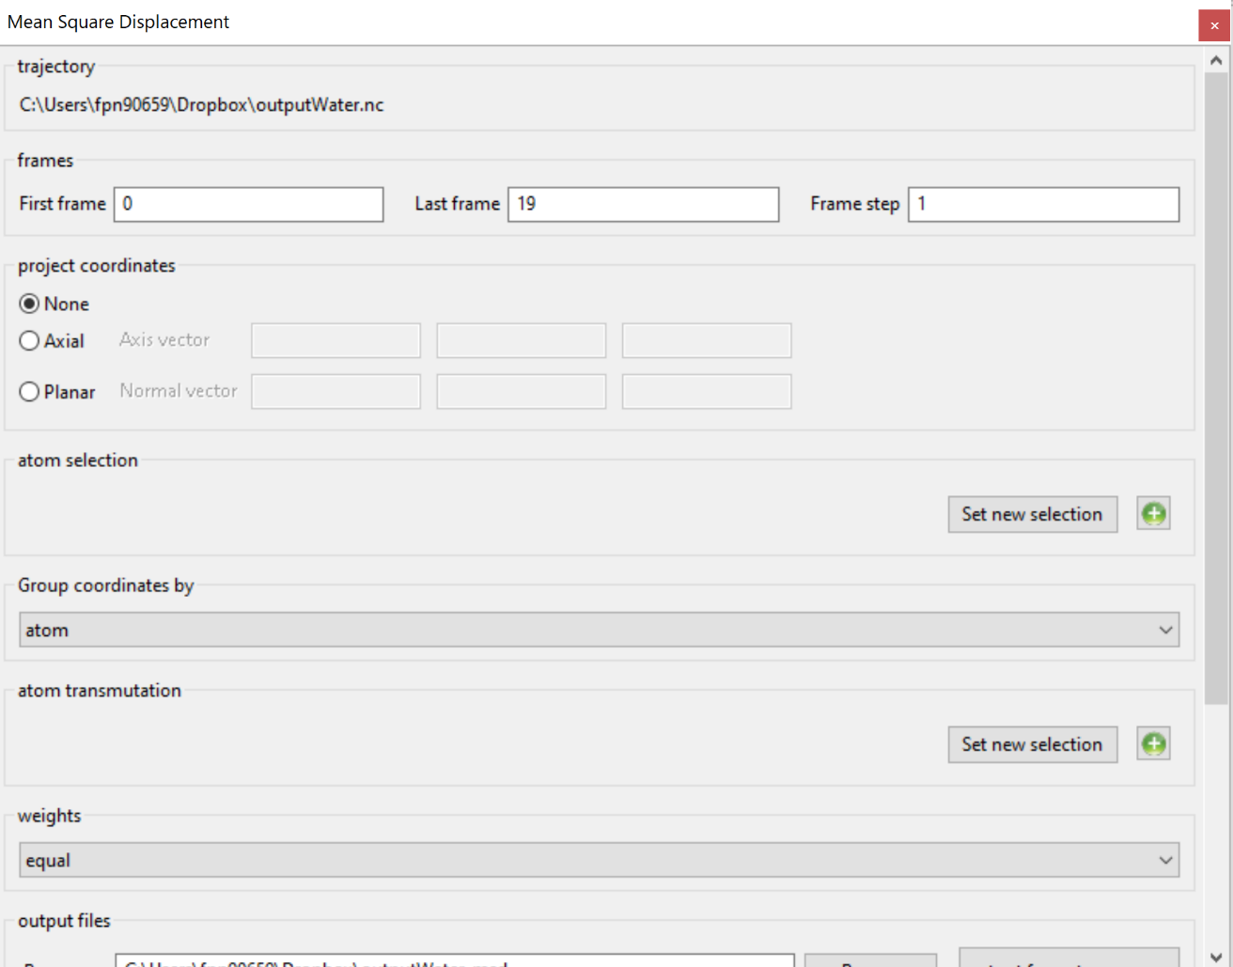
MSD and diffusion coefficients
A metric to compare with QENS
Gradient at long time asymptote gives diffusion coefficient
Typically plotted over a 1 ns period (depends of speed of diffusion)
Shape of MSD can vary for more complex phenomena
E.g. Super Ionic conduction in a sub lattice
E.g. Local diffusion in a restricted geometry (closed pore)

Slide 33
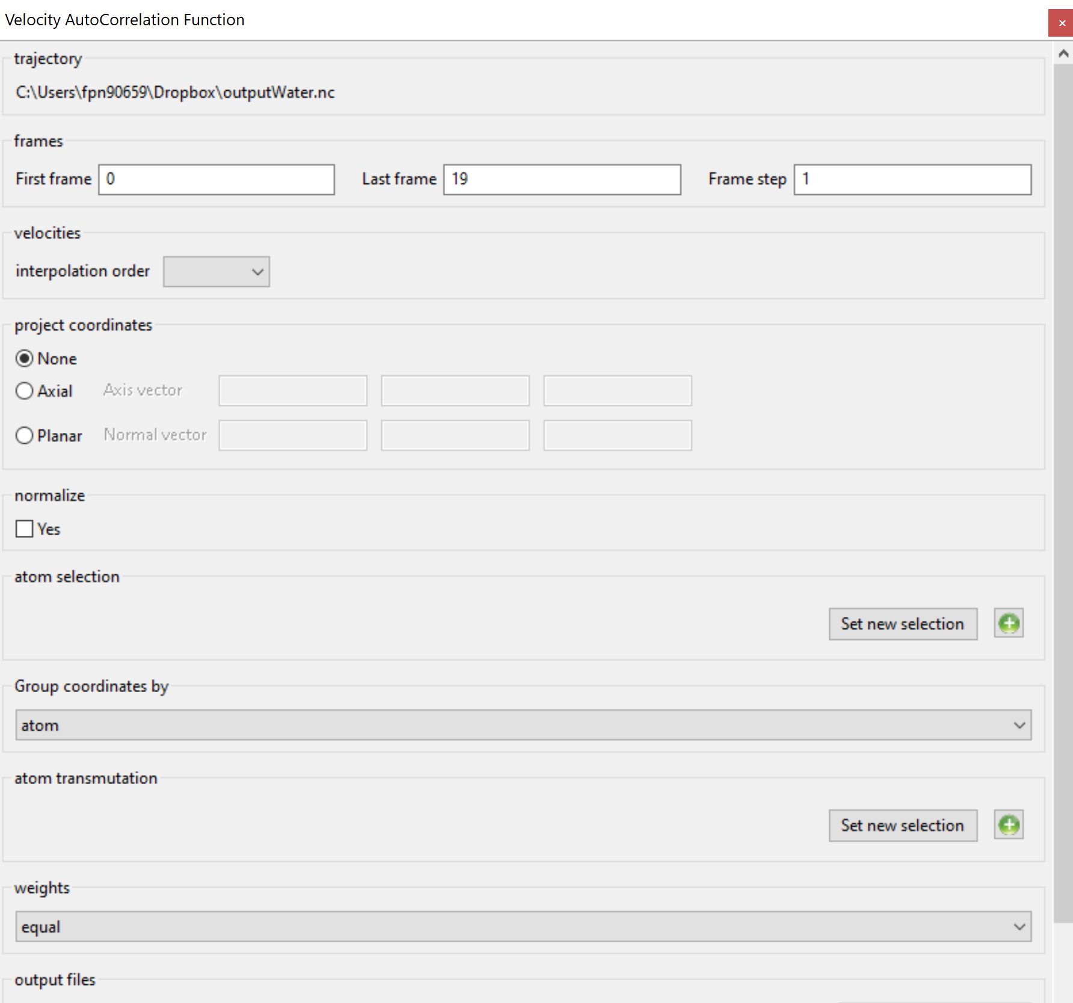
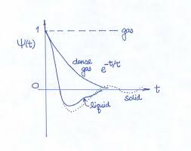
Velocity autocorrelation function
Relates to vibrations, and also diffusion (integral of this is another route to the diffusion coefficient)
Higher printing frequency required

Slide 34
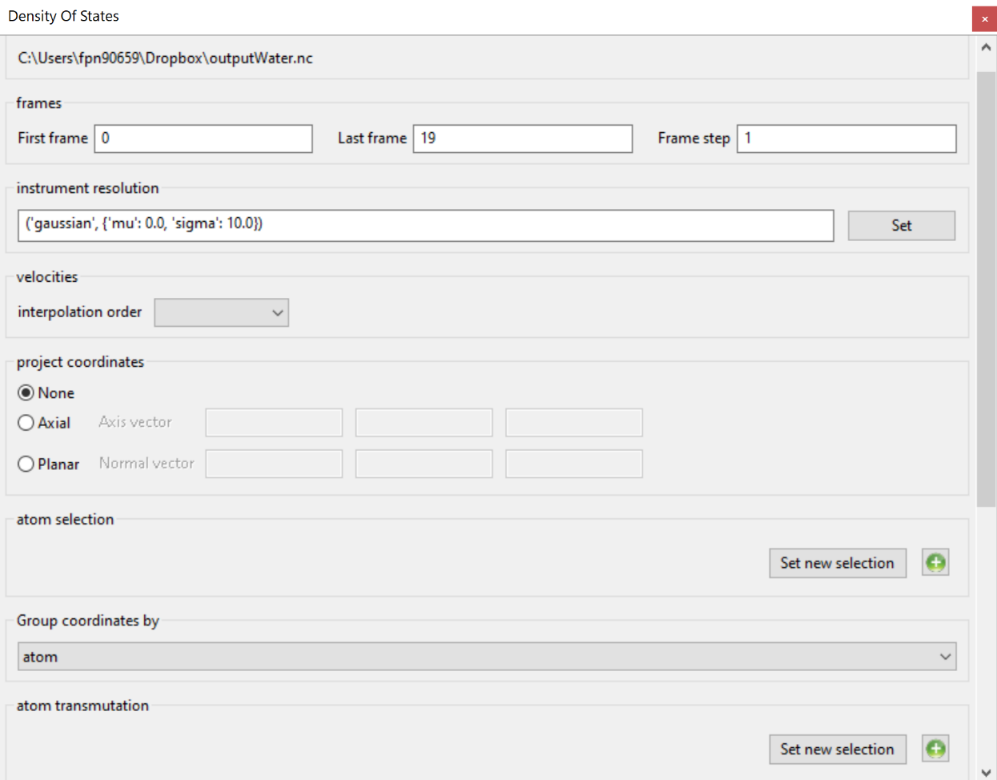
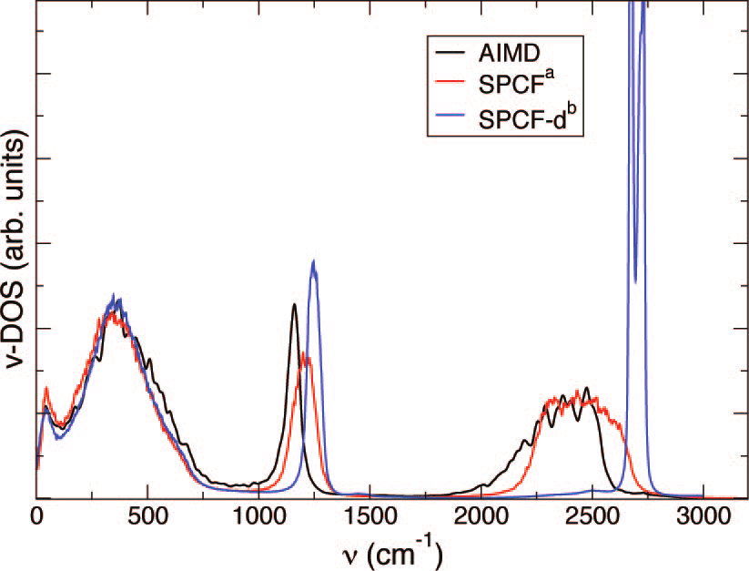
Vibrational density of states (FT of Vel ACF)
This can be compared to TOSCA
Resolution of peaks is included
Can be weighted by neutron cross-section for correct Expt. relative peak intensity
High print frequency as we are now interested in vibrations (fast motions) as well as quite long if we are dealing with a solid, to include slower phonons

Slide 35
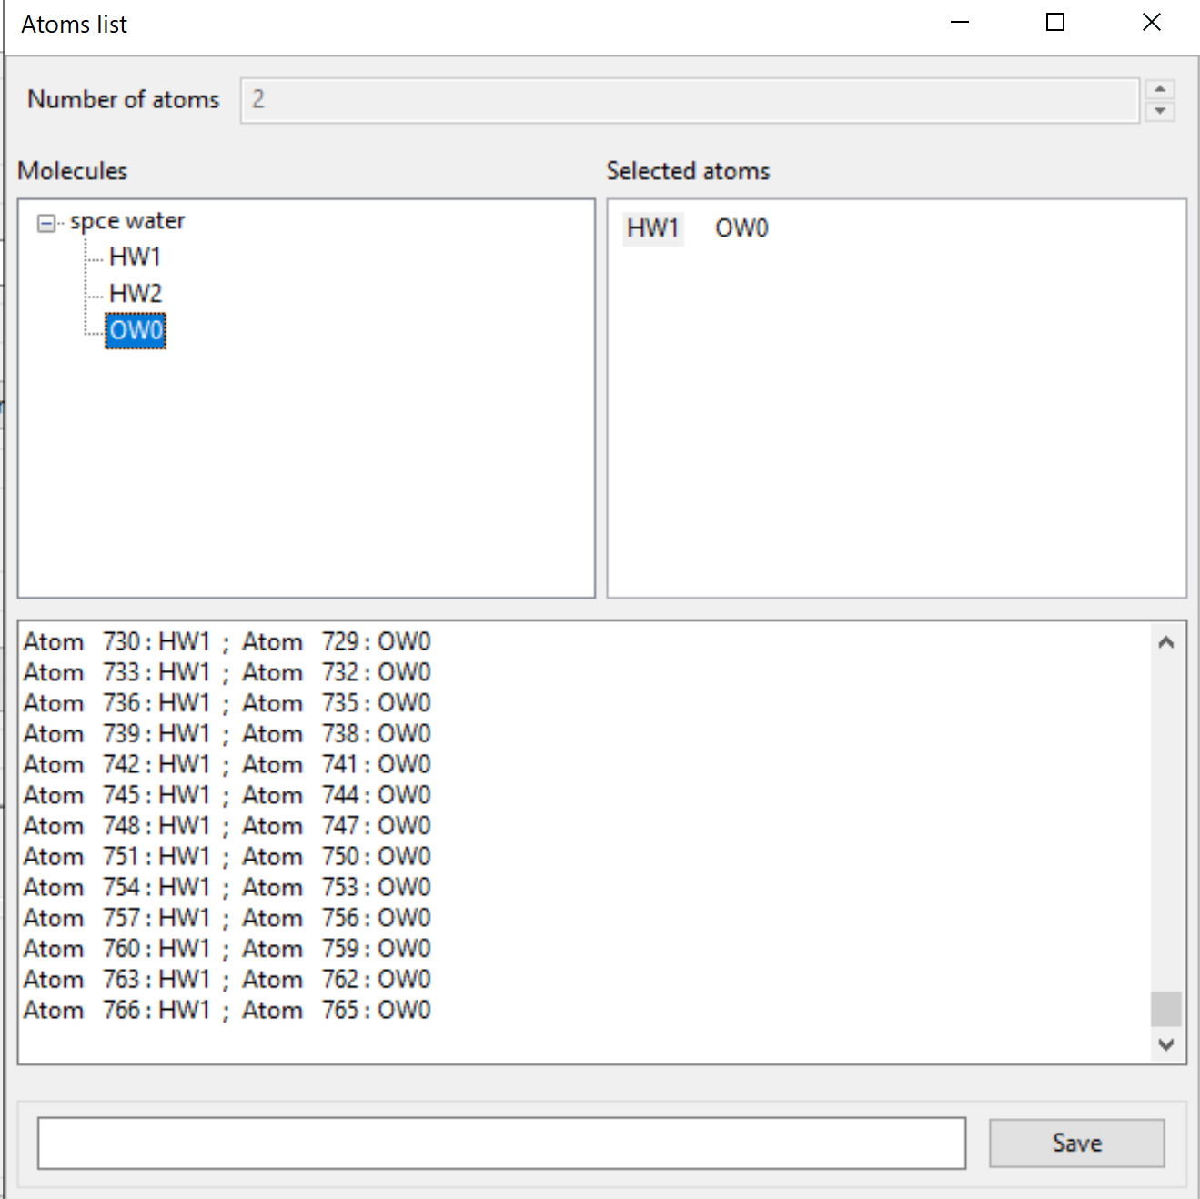
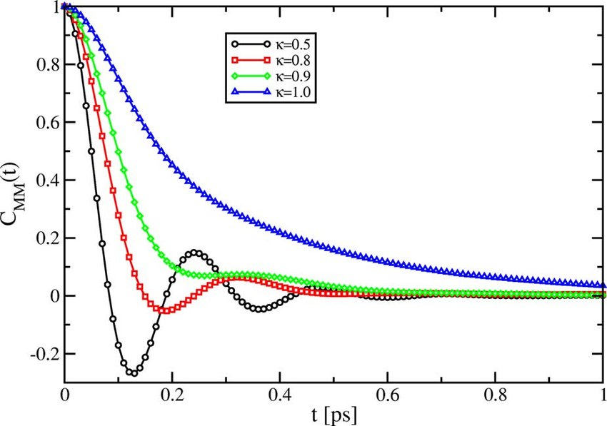
Angular Correlation Function
This can be useful for comparing to QENS
Extract rotational signal
Find relaxation times for different molecular units in proteins
We must define a frame of reference for our angular vector: Typically the vector between two atoms in the molecule

Slide 36
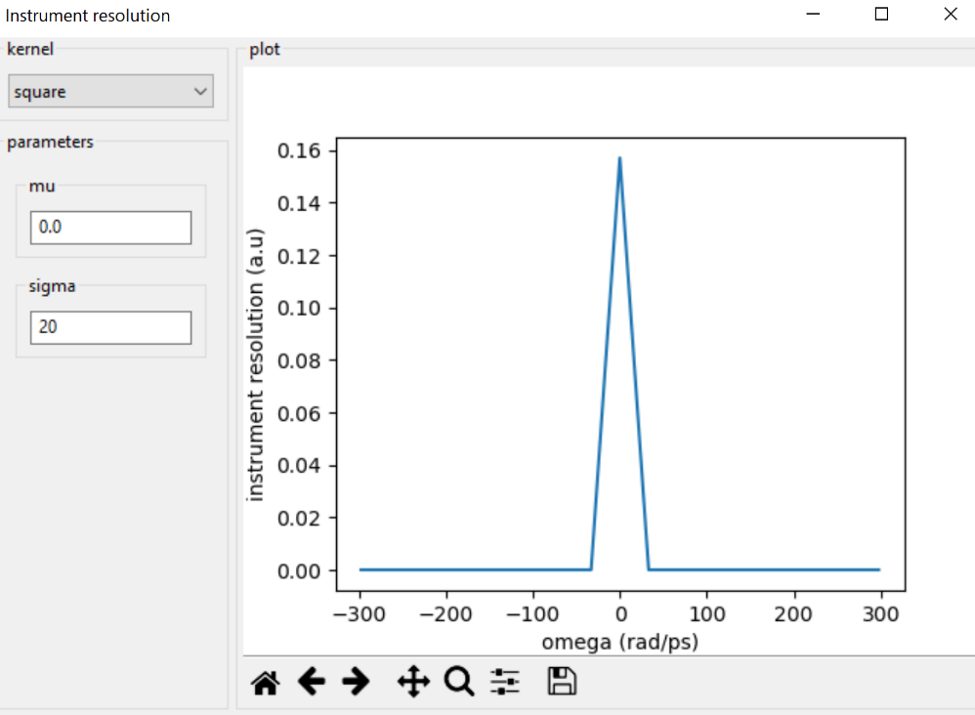
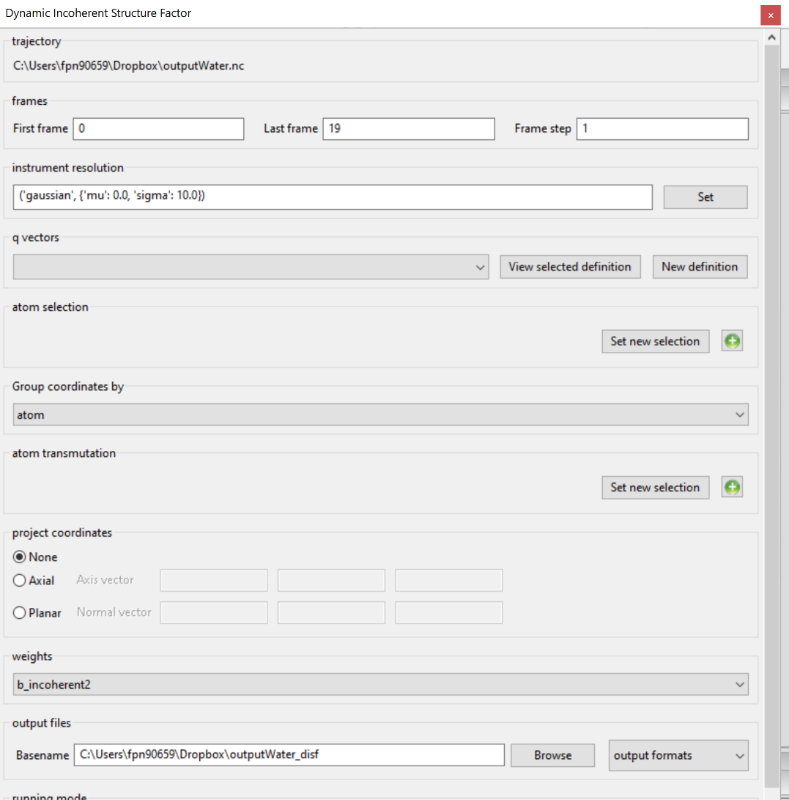
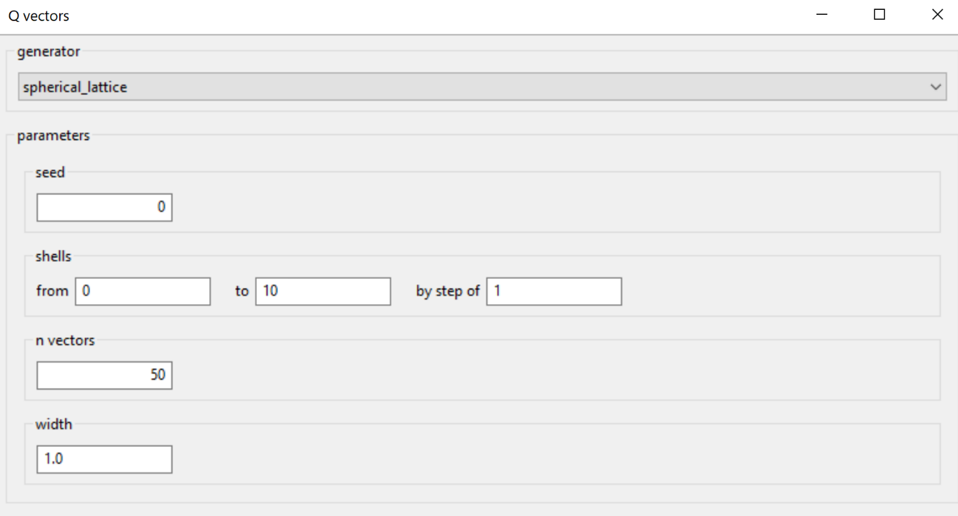
Dynamic Structure factor: IMPORTANT
Note that Incoherent and Coherent are calculated separately
A Q grid must be created (think carefully about ranges)
A resolution function must be specified (usually a Gaussian)
The signals will be weighted by the neutron cross-section
Cautionary warning! MDANSE uses very unusual units (e.g. radians per picosecond for energy and inverse nanometres for Q)

Slide 37
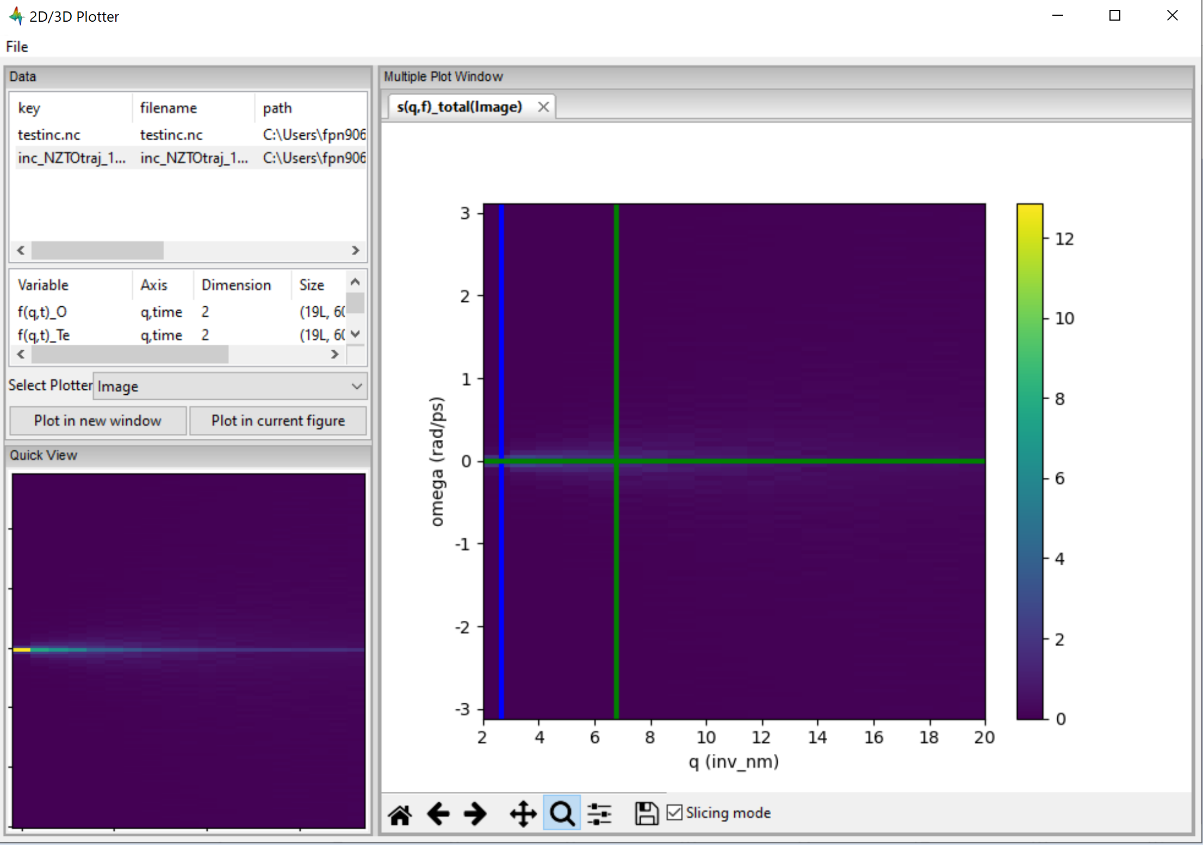
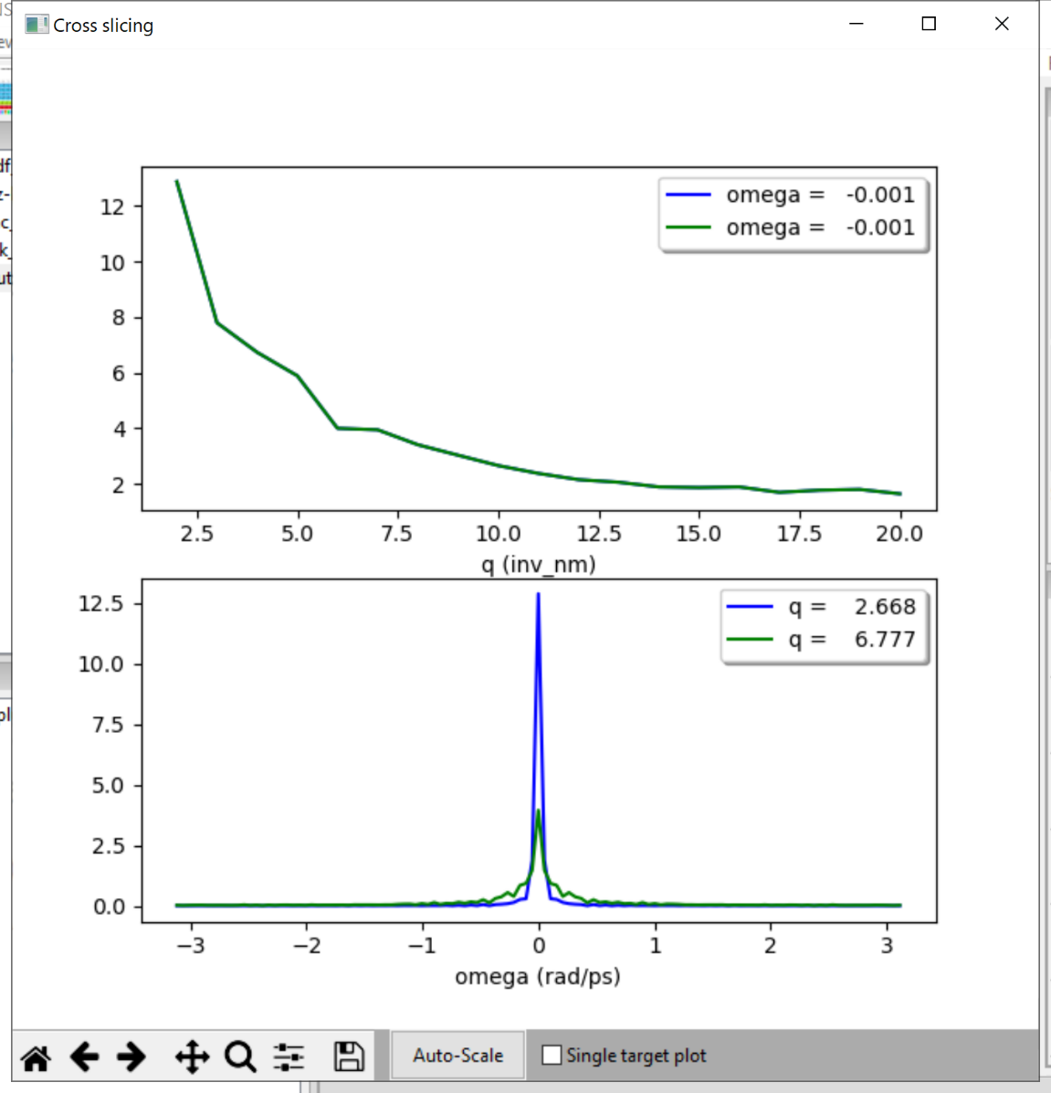
Dynamic Structure factor
MDANSE has an internal visualizer, which allows you to take slices in E/Q, which is very useful for deducing tends
Also useful for working out which regions can be ignored (e.g. Bragg peaks)

Slide 38
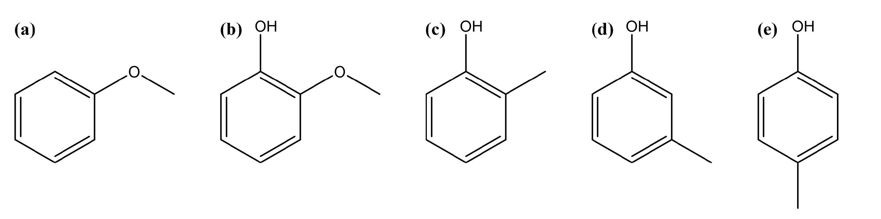
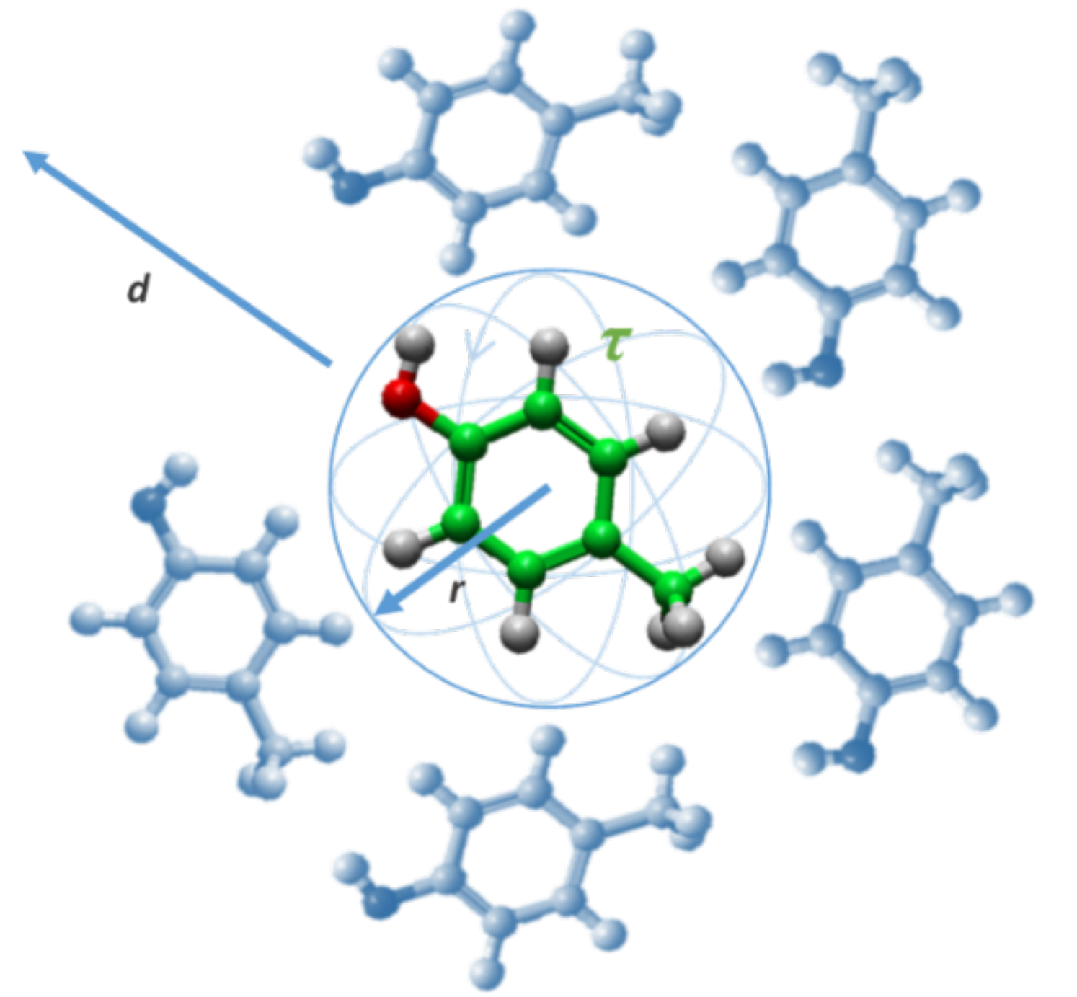
Case study: Liquid lignin monomers
What information can we extract? Potential pitfalls?
Simulations performed on ~5000 atoms
Run times of ~10 ns
Run in DL POLY
Trajectories output every 1000 steps for Structural and Slow dynamics, and every 10 for faster dynamics.

Slide 39
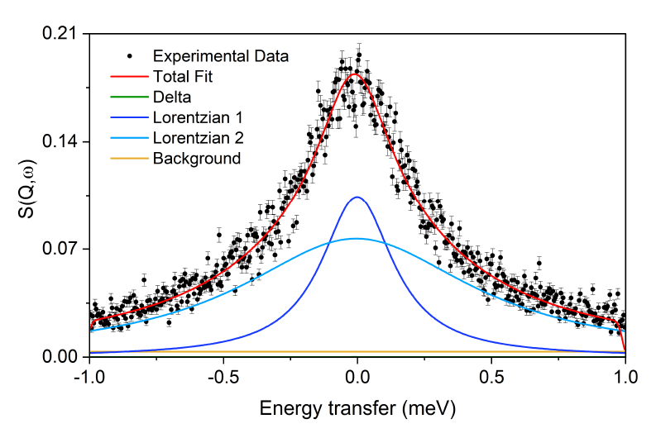




QENS Experiment
Anisole
P-cresol
Fitting of two Lorentzians
One for translational hopping
One for local rotation
This style of fitting can be performed in Mantid (conv fit)

Slide 40

We can generate the S(Q,E) from simulation and perform exactly the same analysis
The accuracy of a model can be determined by how well the S(Q,E) matches
Same fittings applied to Expt and Sim (Extracted diffusion coefficients)
 |  | Expt HR D | Sim HR D
Anisole | 330 | 19.66 | 18.48
 | 360 | 23.345 | 27.11
 | 390 | 35.955 | 33.075
 | E activation | 10.61 | 10.45
Guaicol | 330 | 6.98 | 7.325
 | 360 | 14.375 | 11.41
 | 390 | 18.01 | 18.245
 | E activation | 17.11 | 16.23
o-cresol | 330 | 9.475 | 5.06
 | 360 | 12.635 | 7.785
 | 390 | 20.71 | 13.705
 | E activation | 6.905 | 17.66
m-cresol | 330 | 4.46 | 3.99
 | 360 | 7.885 | 6.285
 | 390 | 13.165 | 8.69
 | E activation | 19.29 | 13.92
p-cresol | 330 | 6.01 | 3.77
 | 360 | 10.33 | 6.545
 | 390 | 13.3 | 9.25
 | E activation | 14.28 | 16.08

Slide 41
Diffusion from MSD
MSD provides the “true” self-diffusion coefficient
Major differences between this value and the fitted models for many simulations
This same error therefore occurs during experimental fittings
 | Temperature (K) | % Difference from MSD
Anisole | 330 | -0.698549167
 | 360 | 7.408874802
 | 390 | -15.58192956
Guaicol | 330 | 25.85910653
 | 360 | -0.262237762
 | 390 | -1.003798155
o-cresol | 330 | 66.99669967
 | 360 | -1.580278129
 | 390 | -2.386039886
m-cresol | 330 | 159.0909091
 | 360 | 52.54854369
 | 390 | -9.948186528
p-cresol | 330 | 153.0201342
 | 360 | 56.2052506
 | 390 | -9.402546523

Slide 42

Why do we see this deviation?
The first derivative of the MSD serves as a time-dependent diffusion coefficient
As each instrument has a limited time-scale, it can only sample motions within this range
The fastest systems in this study arrive at the self-diffusion asymptote within the instrument range, whereas the slower systems have not reached this “Fickian” regime

Slide 43
What about the rotations?
Accurate for faster systems (E.g. Anisole 390 K)
Slower systems display multiple exponential decays (~3 for m-cresol 330 K) with different time scales
The largest portion of motions come from the slowest relaxation, which is 30 times slower than that extracted from FWHM fitting
Fittings in slow regime in general are inappropriate. Likely mostly fitting local motions (delta function probably accounting for some of these very slow motions)
3 exponential fit to m-cresol 330 K

Slide 44

Radial distribution functions can highlight hydrogen bonding trends
Increased hydrogen bonding indicated by higher O-H peak height
This can then explain differences in diffusion/rotation between models
p-cresol and m-cresol
Strong h-bonding, sharp peaks at close distances
o-cresol
h-bonding restricted by adjacent methyl group, larger bonding distance
guaiacol
Bulky groups, broader range of bonding distances due to steric hindrance

Slide 45


H-bond distributions (from VMD)
H-bonds can be detected with certain distance and angle criteria
These distributions can be evaluated over the course of the simulation
They can also be plotted visually
More complex method is to look at h-bond lifetimes

Slide 46
Matching Structure with MD/MC (EPSR)
Simulations, coupled with a progressive alteration of the force-field parameters via a figure of merit (deviation form Expt. data)
Convergence towards a force-field which reproduces the neutron results
Force-fields may be meaningless from a dynamics point of view (configurational space only correct)

Slide 47

Fitting MD models with Neutron Data (MDMC)

Slide 48

Questions?

